Slide 1
Indications for Diagnosing Splenic Injury and Surgery
Adam Khan, MS3

Slide 2
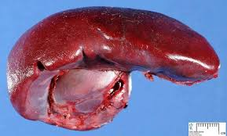
Why Splenic Injuries Matter
The spleen plays a key role in immunologic function, filtering blood, and managing red blood cells and platelets
Highly vascular, making it particularly susceptible to hemorrhage after trauma
Splenic injury is the most common solid organ injury in blunt abdominal trauma
Prompt diagnosis is essential to prevent life-threatening hemorrhage

Slide 3
02
Mechanisms of Splenic Injury

Slide 4
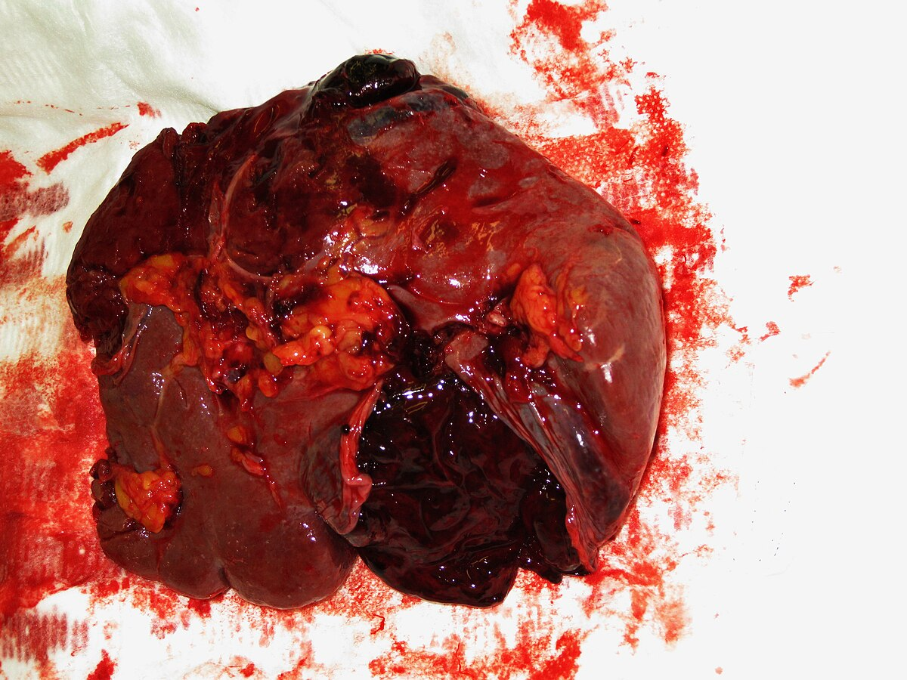
Blunt Trauma
~80–90% of splenic injuries
High-energy forces cause deceleration or compression of the spleen
Often associated with: Motor vehicle collisions (MVCs), Falls from height, Sports injuries (e.g., football, skiing, cycling accidents)
Penetrating Trauma
Less common, but often more severe
Stab wounds, gunshot wounds, etc.
Iatrogenic Trauma
Less frequent, but possible during:
Colonoscopy, Abdominal surgeries, ERCP

Slide 5
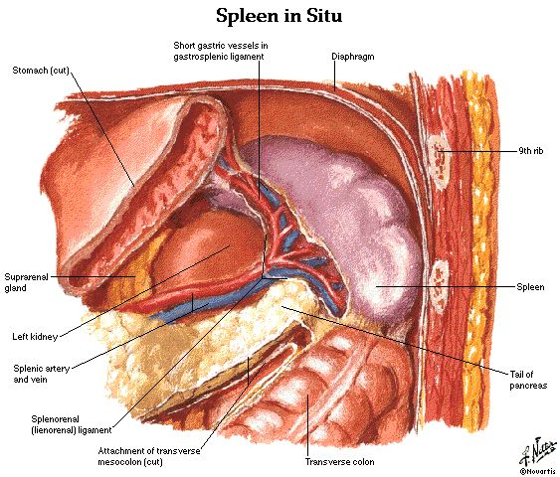
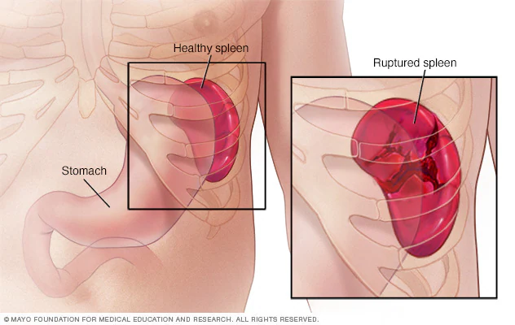
Anatomical Vulnerabilities
The spleen’s location in the LUQ, just beneath the left ribs makes it vulnerable in:
Lower left rib fractures (especially ribs 9–12)
Rapid deceleration or lateral compression injuries
Associated Injuries:
Left diaphragm injury
Pancreatic tail trauma
Left kidney or adrenal injuries
Key Takeaway: Always suspect splenic injury in patients with blunt abdominal trauma and left-sided thoracoabdominal trauma, especially with hypotension or LUQ tenderness.

Slide 6
03
Indications for Diagnosing Splenic Injury

Slide 7
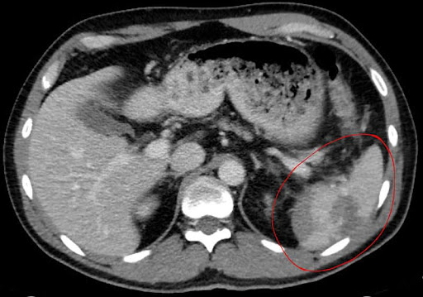
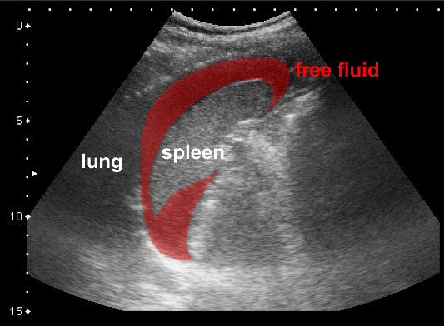
Clinical Signs:
LUQ abdominal pain or tenderness
Left shoulder pain (Kehr’s sign)
Hypotension, tachycardia
Physical Exam:
Abdominal distension, guarding, peritonitis
Imaging Indications:
FAST exam for unstable patients
CT with IV contrast for stable patients
Associated Injuries:
Lower left rib fractures, other solid organs

Slide 8
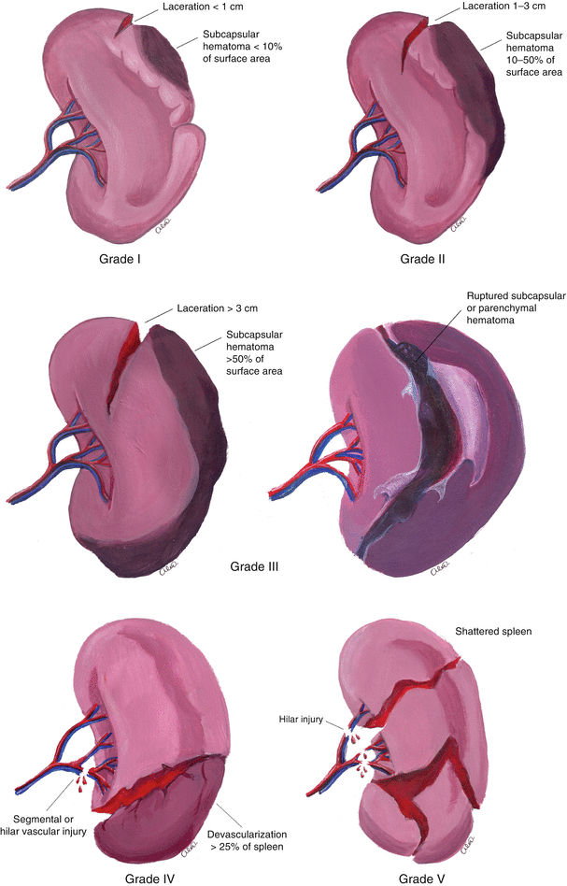
Grade I: Subcapsular hematoma <10%, capsular tear <1 cm
Grade II: Hematoma 10–50%, laceration 1–3 cm
Grade III: Hematoma >50%, laceration >3 cm
Grade IV: Segmental or hilar vessel injury with devascularization
Grade V: Shattered spleen or hilar vascular injury with devascularization of entire spleen

Slide 9
05
Indications for Surgical Management

Slide 10
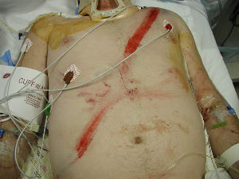
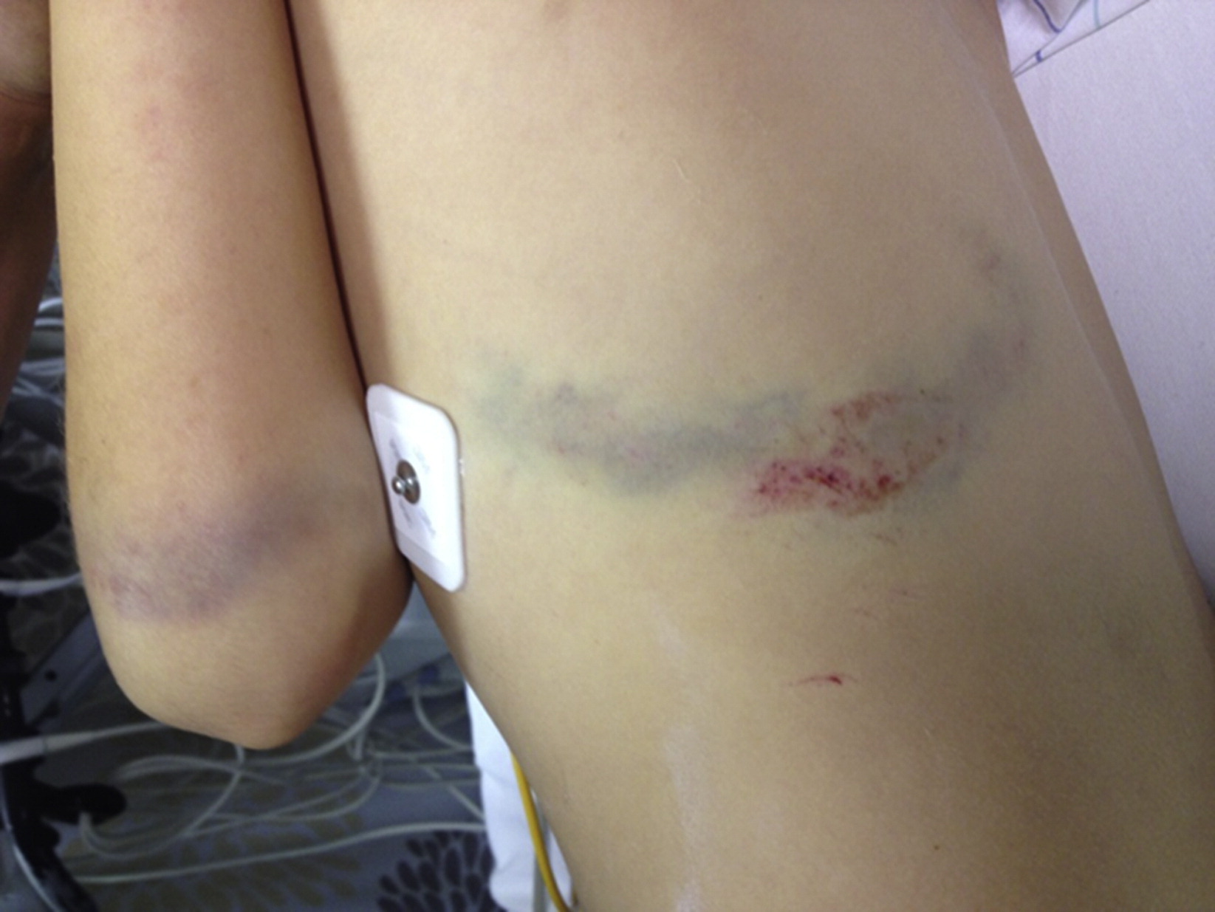
Hemodynamic instability despite adequate resuscitation
Positive FAST with clinical signs of hemorrhage
High-grade injury (Grade IV–V) with active bleeding
Failure of non-operative management
Associated injuries requiring laparotomy
Expanding or uncontrolled hemoperitoneum

Slide 11
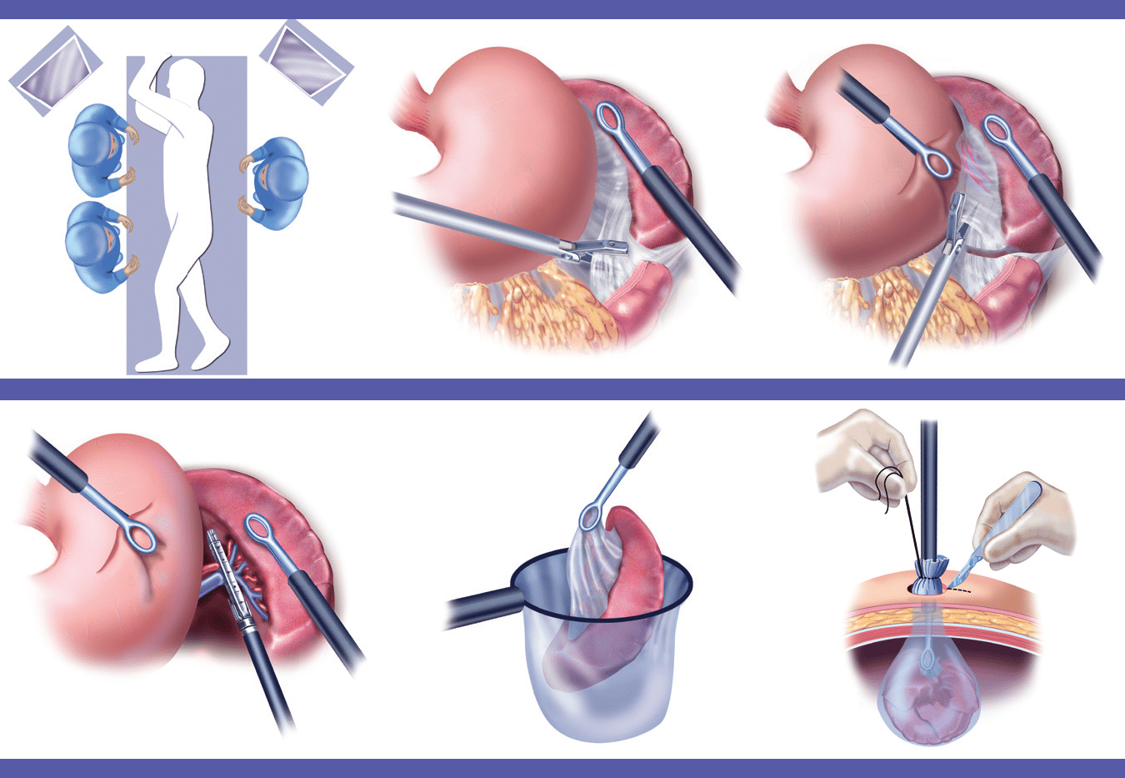
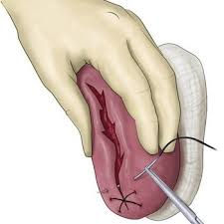
Splenectomy: Definitive and common in unstable patients
Splenorrhaphy or Partial Splenectomy: Possible in lower-grade injuries, especially in pediatric or young adult patients
Laparotomy: Preferred in emergencies
Laparoscopic Splenectomy: Possible in stable patients with isolated injury

Slide 12
07
Postoperative Considerations

Slide 13
Vaccinations Required after Splenectomy:
Pneumococcus, Haemophilus influenzae type b, Meningococcus
Timing: Ideally before discharge or at least within 2 weeks post-op
Risk of Overwhelming Post-Splenectomy Infection (OPSI)
Life-threatening sepsis caused by encapsulated bacteria
Highest risk within first 1–3 years, but lifelong risk persists
Mortality can exceed 50% if not treated promptly
If Partial Splenectomy:
Residual spleen may still provide partial immune protection
Still vaccinate, but risk of OPSI is lower than after total splenectomy
Antibiotic Prophylaxis:
Daily oral penicillin VK (or amoxicillin) may be recommended, especially for:
Children < 5, 1-2 years post-splenectomy

Slide 14
08
Non-Operative Management (NOM)

Slide 15
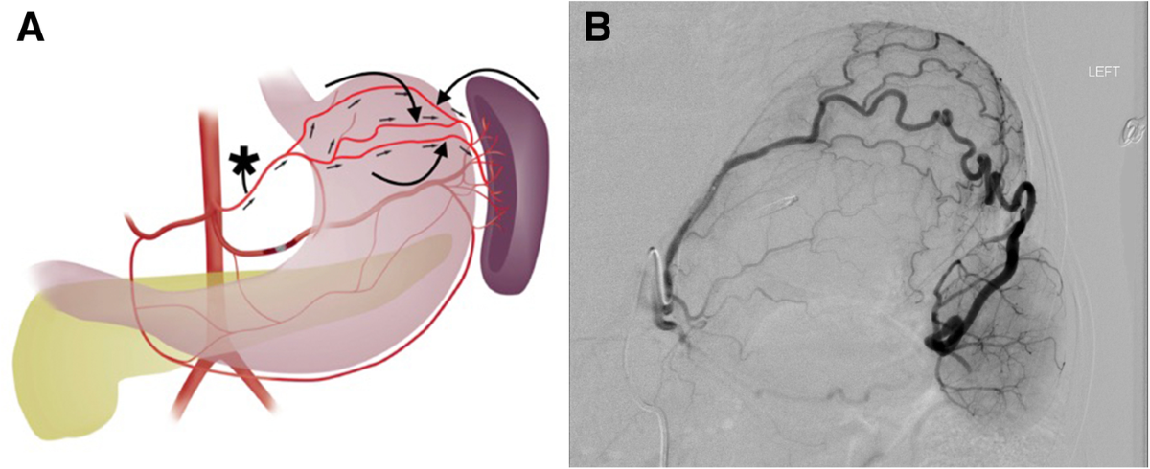
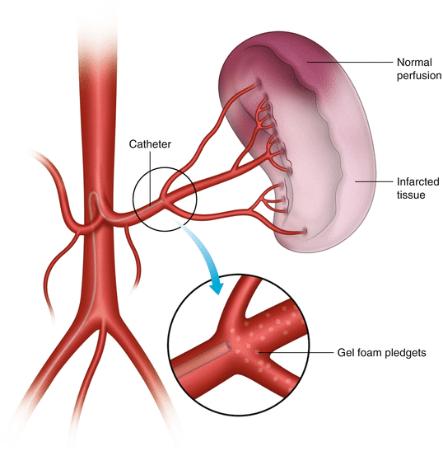
Who is Eligible for NOM?
Hemodynamically stable patients:
No peritonitis or signs of ongoing bleeding
No other intra-abdominal injuries requiring surgery
Management Steps
Serial vital signs, hemoglobin/hematocrit checks
Admission to monitored unit (ICU for higher-grade injuries or older/comorbid patients)
CT typically repeated if clinical change (e.g., new pain, Hgb drop)
Splenic Artery Embolization
Used in stable patients with active contrast extravasation on CT
Can prevent surgery in many Grade III–IV injuries

Slide 16
09
Summary

Slide 17
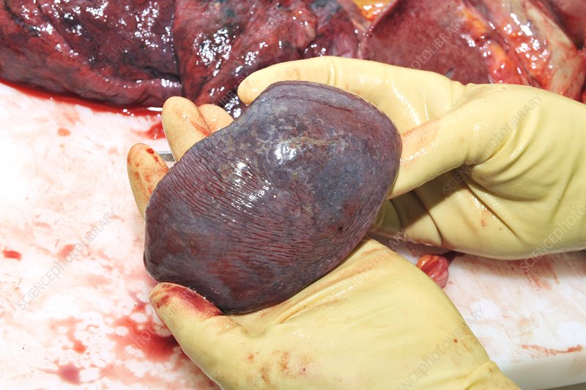
Early identification of splenic injury is critical
Hemodynamic status determines diagnostic and management strategy
Surgery is indicated in unstable patients or if NOM fails.
Splenic preservation is preferred when safe and feasible.
The first recorded splenectomy is believed to have been performed in Naples in 1549*

Slide 18
American Association for the Surgery of Trauma (AAST). Spleen Injury Scale. Moore EE, Feliciano DV, Mattox KL. Trauma, 9th ed. McGraw Hill; 2020.
UpToDate. Management of splenic injury in adults. Author: Matthew R. Rosengart, MD, MPH. Advanced Trauma Life Support (ATLS®) Guidelines. American College of Surgeons, 10th Edition. Bala M, et al. Management of blunt splenic injury: an update. J Trauma Acute Care Surg. 2017;82(4):787-793. Peitzman AB, et al. Blunt splenic injury in adults: multi-institutional study of the Eastern Association for the Surgery of Trauma. J Trauma. 2000;49(2):177-187.
Kozar RA, et al. Practice management guidelines for the nonoperative management of blunt injury to the liver and spleen. J Trauma. 2008;65(5):1179–1185. Velmahos GC, et al. Selective nonoperative management in 1,856 patients with abdominal gunshot wounds: evolution of a treatment paradigm. J Trauma. 2001;50(4):653–663. Santucci RA, et al. A proposed algorithm for the nonoperative management of blunt splenic trauma. Am J Surg. 2001;182(6):596–600.

Slide 19
THANK YOU

