Slide 1
Biologic agents in the treatment of Hidradenitis Suppurativa
Patrick Jedlowski, MS3
University of Arizona College of Medicine - Tucson
7-31-2018

Slide 2
Learning Objectives
Define Hidradenitis Suppurativa (HS), its clinical presentation and pathogenesis
Outline the surgical management of HS
Define biologic agents, their mechanism and usage in HS
Compare and contrast the outcomes of surgical vs. pharmacological management with biological agents of HS

Slide 3
Hidradenitis Suppurativa – clinical presentation
Deep, tender suppurative subcutaneous nodules with fibrosis and development of sinus tracts between lesions → indurated plaques and thick linear scars band
Nodules can progress to form abscesses that drain purulent discharge to the skin or to neighboring structures
Primarily occurs in areas rich with apocrine glands
Axillae (most common), perianal, perineum, inguinal, inner thighs, mammary, inframammary
Varying severity in clinical picture
Hurley staging system
Prevalence of ~0.1-1% in general population
Patil et. al 2018, Gard et. al 2017

Slide 5
Pathogenesis of HS
The pathogenesis of HS is most likely multifactorial
Initially thought to be a primary apocrine gland disorder
Now thought to structural abnormality and secondary inflammation of the pilosebaceous unit
Structural changes → occlusion of the pilosebaceous unit → perifollicular inflammation
Epithelial stem cells in bulge of hair follicle → subcutaneous sinuses/tracts
Immune dysregulation (innate and adaptive) → Overexpression of cytokines
Both structural changes and immune dysregulation are necessary to develop HS
Infection is a secondary pathogenic factor – makes disease works but does not cause it
Napolitano et. al 2018

Slide 6
HS Risk Factors
Female gender (3-5:1 ratio of females to males with HS)
Cigarette smoking
Obesity
Genetics / Family history (30-40% of patients have positive FHx)
Hormones / oral contraceptives (onset in puberty)
Mechanical stress (follicular rupture)
Associated syndromes:
IBD/Crohn’s disease
Follicular occlusion tetrad
PAPASH syndrome (pyogenic arthritis, pyoderma gangrenosum, acne vulgaris, suppurative hidradenitis syndrome)

Slide 7
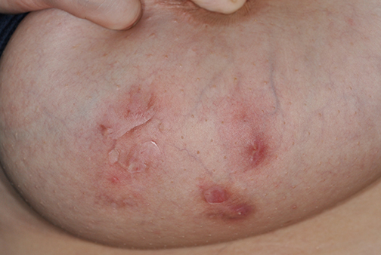
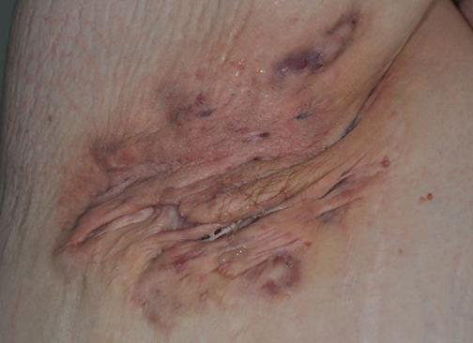
Hurley Staging system
Hurley Stage 1
Nodules/abscess
No scarring or sinus tracts
Hurley Stage 2
Recurrent abscesses
Sinus tract formation
Hurley Stage 3
Diffuse involvement
Multiple interconnected sinus tracts and abscesses
Ingram et. al 2018, Hidradenitis suppurativa: Treatment (UpToDate)

Slide 8
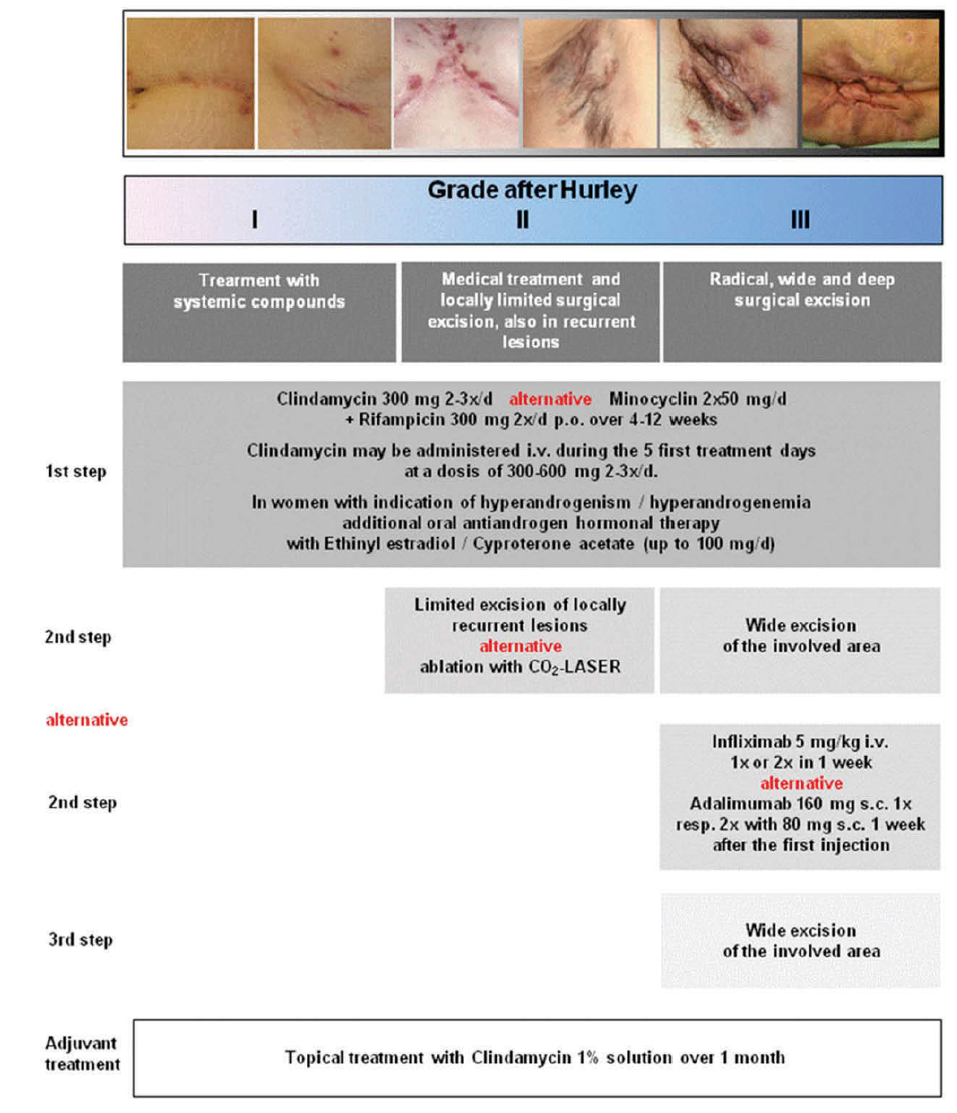
Treatment of HS – A stepwise approach
Zouboulis et. al 2016

Slide 9
Surgical management of HS
Punch debridement
Hurley Stage I/II
Unroofing (local or extensive)
Hurley Stage II/III
Local incision and drainage
Used when painful abscess is present
Does not clear actively growing tissue
Wide excision and reconstruction
Hurley Stage III
Excision can heal by primary or secondary intention
Can use skin grafts/flaps for larger excisions
New method uses “recycled” skin grafts from site of disease
Others : CO2 laser

Slide 10
Who surgically manages HS?
*No difference in complications between general surgery and plastic surgery in skin graft procedures
Ruan et. al 2018

Slide 11
Use of biologic agents in HS - rationale
Biologics = large, complex molecules that are produced within a living system (cell culture) using recombinant DNA technology
Why biologics in HS?
Immune dysregulation - Inflammatory cytokines (IL-1, TNFa, IL-10, IL-12, IL-23) have been found to be elevated in HS lesions
Levels of inflammatory cytokines within intralesional skin may correlate with severity of disease
Patients with HS have higher circulating levels of inflammatory cytokines (TNFa) in serum
Increased numbers of Th17 cells noted HS lesion
Two classes of biologics used in HS:
Anti-TNFa therapy
Anti-Interleukin therapy
Patil et. al 2018, Moran et al. 2017

Slide 12
Anti-TNF therapy
Remicade ®
Humira ®
Enbrel ®
IV administration
Infliximab (Remicade ®)
Subcutaneous Injection
Etanercept (Enbrel ®)
Adalimumab (Humira ®)
Most evidence exists for use of Adalimumab in HS, Infliximab and Etanercept may not be as effective

Slide 13
Adalimumab (Humira ®)
ONLY FDA APPROVED BIOLOGIC USED IN HS
Mechanism: Human monoclonal antibody against TNFa
Binds to serum and membrane-bound TNFa → blocks inflammatory signaling
Leads to downstream decrease in IL-1B, CXCL9 and BLC
Reduced numbers of inflammatory lymphocytes in HS lesions after treatment
USE: Inflammatory active HS lesions (not useful in inactive, scarring lesions)
Zouboulis et. al 2016, Martin-Ezquerra 2016

Slide 14
Adalimumab (Humira ®)
Retrospective studies: Cumulative response rate of 58.9%
Open prospective studies: 74.4% patients experienced significant improvement
Beneficial effect, if any, will be observed between weeks 4-12
Dosage: 160 mg day 0 → 80 mg on week 2 → 40 mg once weekly from week 4 onward
Treatment must be sustained
Relapse occurs in 86.2% of patients at 11 weeks after discontinuation
Retreatment after relapse is equally effective
PIONEER Trials (Phase III clinical trials of Hurley stage II/III disease)
17.6% of patients achieved 2-grade reduction in Hurley score

Slide 16
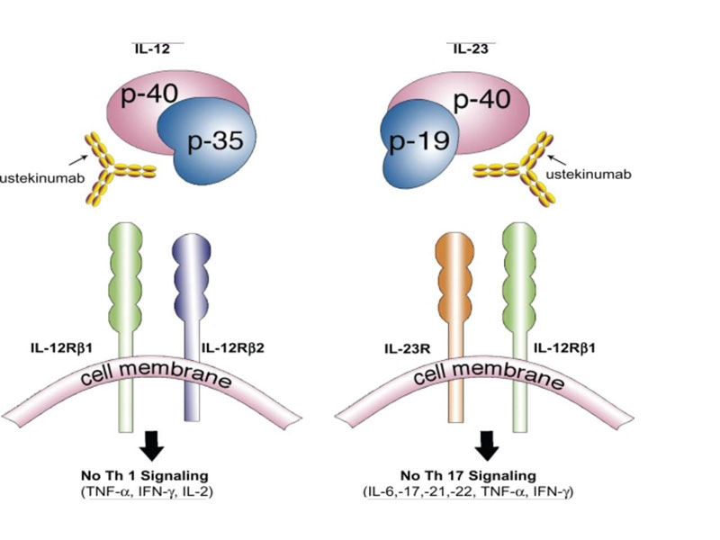
Anti-interleukin therapy
Ustekinumab (Stelara ®)
Anakinra (Kinaret ®)
Binds to p40 subunit of both IL-12 and IL-23
47% of moderate/severe HS patients have clinical response improvement at week 40
IL-1B Receptor antagonist
Improvement in disease activity in 67% of patients (vs. 20% in placebo)

Slide 17
Biologic agents, concerns:
COST
Immunosuppression
Need to screen for infection, latent Tb, HIV and viral hepatitis
Contraindicated in pregnancy
3-5:1 ratio of females to males with HS
Onset in puberty (child bearing age)
Risk of causing other dermatologic complications (paradoxical psoriaform reactions)
Annual cost of biologics used in treatment of HS

Slide 18
Comparison of treatments for HS
Surgery
Biologics
Low rate of disease recurrence in wide excision procedures
Highly successful in gluteal, perineal/perianal disease – possibly curative
Risk of morbidity
Wound dehiscence
Post-op transfusion
Reoperation
Readmission
Significant risk for scarring
May be used as an alternative second step before surgery in Hurley grade III patients
Can be used as an adjuvant therapy to “cool” an area before surgery
Can result in dramatic reduction in disease severity as measured by Hurley score
Can then use more conservative surgery
Useful in managing disease refractory to initial therapy
Risks:
Immunosuppression
Financial burden
Risk of relapse with discontinuation

Slide 19
Take home points
Hidradenitis suppurativa is a relatively rare disease with significant morbidity associated with the natural history of disease
Mechanistically related to structural abnormalities of the pilosebaceous unit and immune dysregulation
Options for treatment have classically involved systemic treatment with antibiotics/antiandrogens and surgical intervention
Biologics represent a new therapeutic intervention with HS, that can be used as a viable alternative or adjuvant for surgical therapy
Biologics are expensive on an annual basis and may need to be continually used due to risk of relapse with discontinuation
Surgery is still, to date, the most cost-effective management option for severe (Hurley Stage III) disease
Biologics can be used before surgery; less extensive surgery required
General surgeons manage a majority of surgical HS patients, with similar rates of complications compared to plastic surgeons

