Slide 1
Biliary Tree Anatomic Variations
Mary Nguyen, MS3
University of Arizona College of Medicine - Tucson

Slide 2
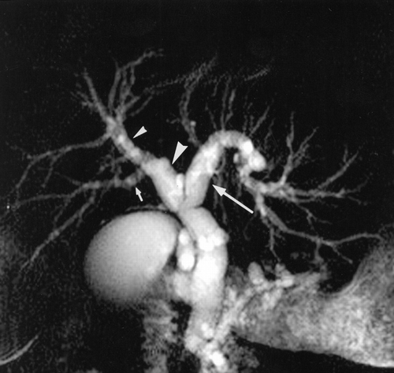
Normal
Right posterior duct passes posteriorly to the right anterior duct and joins it from the left to form the right hepatic duct, which then forms a junction with the left hepatic duct to form the common hepatic duct

Slide 3
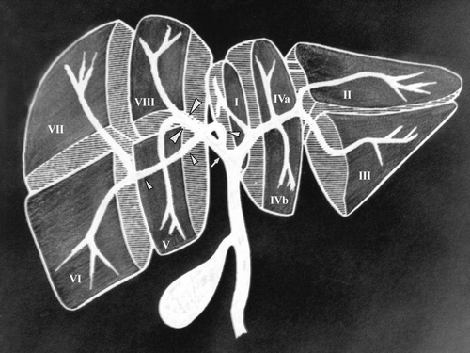

Slide 4
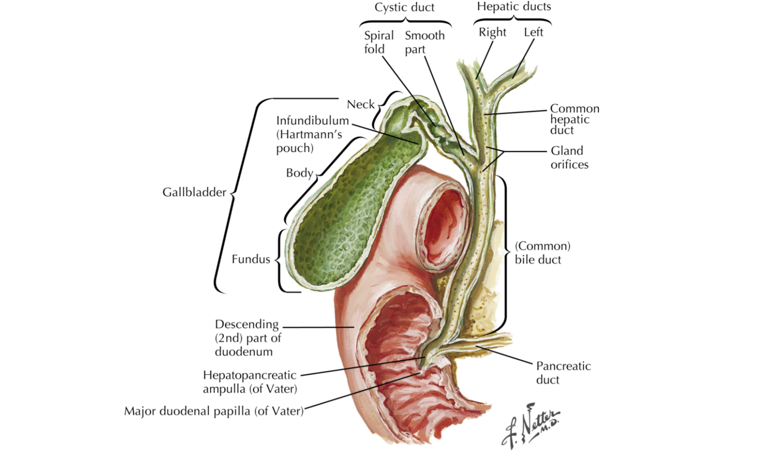
For 64% to 75% of the population, the cystic duct joins the hepatic duct at approximately a 40-degree angle

Slide 5
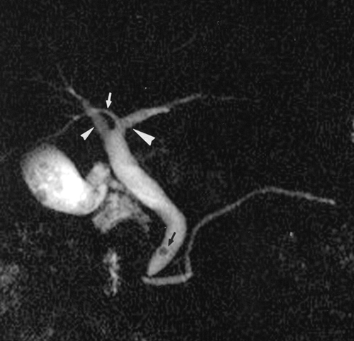
Most Common Variations
In 13-19% of population, right posterior duct drains into left hepatic duct before joining with right hepatic duct

Slide 6
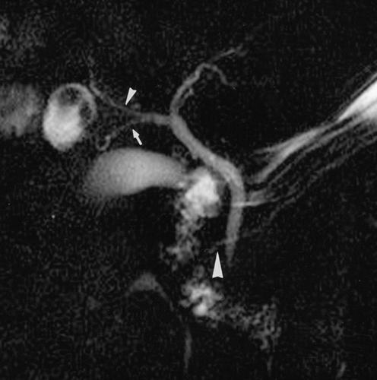
For 12% of the healthy population: right posterior duct empties into right aspect of right anterior duct (does not pass posteriorly)

Slide 7
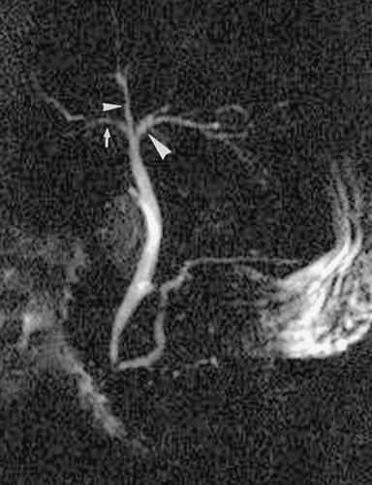
In 11% of population: “Triple confluence” where right posterior duct, right anterior duct, and left hepatic duct empty into common hepatic duct. Right hepatic duct is virtually nonexistent

Slide 9
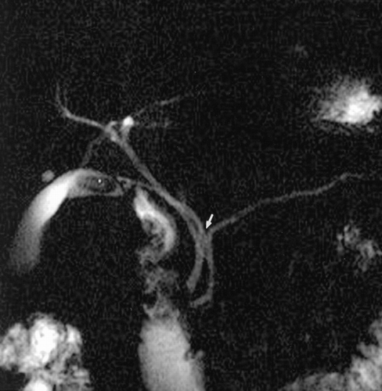
Cystic Duct Variations
8% of presentations are a low cystic duct insertion (distal third of extrahepatic bile duct)
10-17% joins medially on left side of common hepatic duct

Slide 10
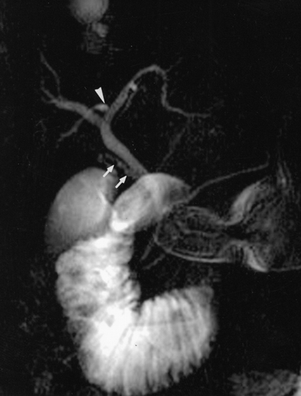
1.5-25% parallel course of the cystic duct and common hepatic duct follows an adherent course

Slide 11
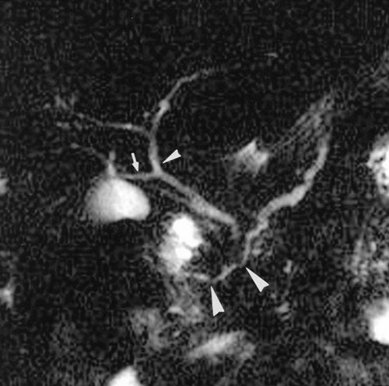
Uncommon
5% drainage of right posterior duct into common hepatic duct (right-sided)

Slide 12
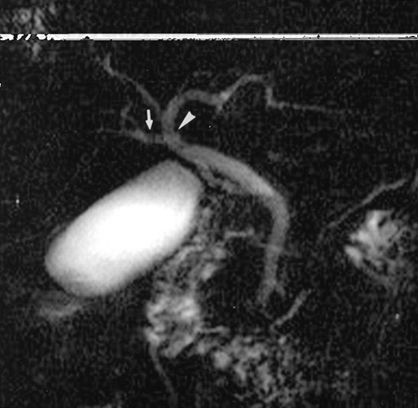
<1% of population drainage of right posterior hepatic duct into common hepatic duct (left-sided)

Slide 13
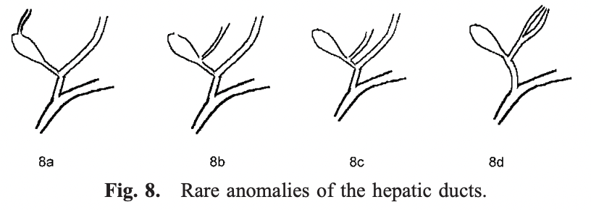
Hepatic Duct

Slide 14
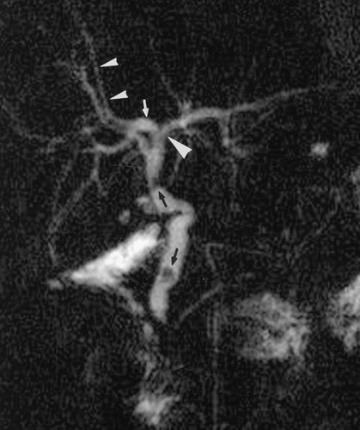
Drainage of accessory right anterior duct into right posterior duct (small arrowheads)
Accessory hepatic ducts are observed in 2% of patients

Slide 15
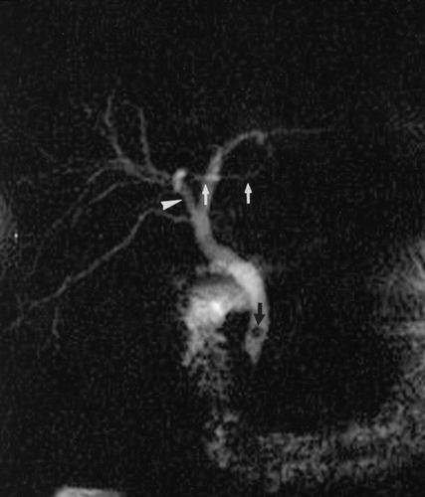
Accessory left hepatic duct (white arrows) draining into right anterior duct (arrowhead)

Slide 16
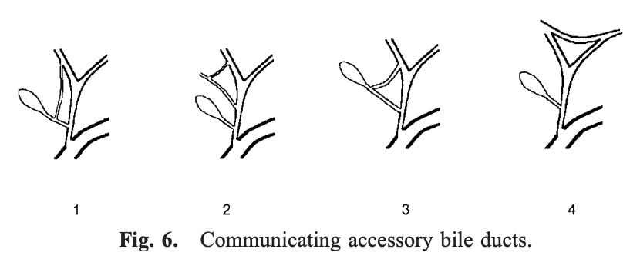

Slide 17
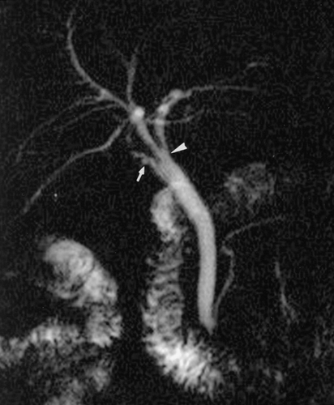
Uncommon Cystic Ducts
High fusion of cystic duct with common hepatic duct

Slide 18
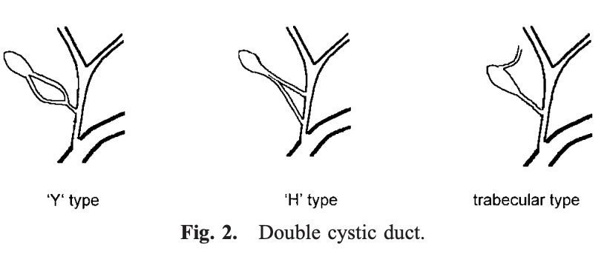

Slide 19
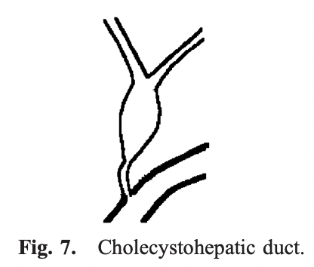
Hepatic ducts drain into the gallbladder and the cystic duct drains into the duodenum

Slide 20
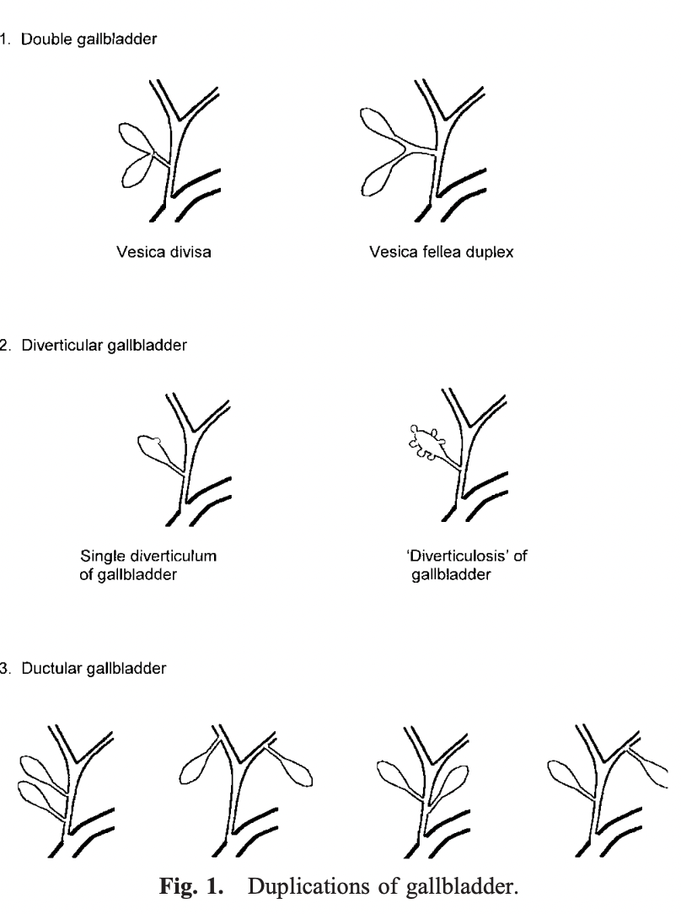
Variations in Gallbladder

Slide 21
Implications in Surgery
Wide variability might exist, but dissection during laparoscopic cholecystectomy shows a limited anatomical area which is largely constant

Slide 22
References
Lamah, M., Karanjia, N. d., & Dickson, G. h. (2001). Anatomical variations of the extrahepatic biliary tree: Review of the world literature. Clinical Anatomy, 14(3), 167–172. https://doi.org/10.1002/ca.1028
Larobina, M., & Nottle, P. D. (2005). Extrahepatic Biliary Anatomy at Laparoscopic Cholecystectomy: Is Aberrant Anatomy Important? ANZ Journal of Surgery, 75(6), 392–395. https://doi.org/10.1111/j.1445-2197.2005.03396.x
Mortelé, K. J., & Ros, P. R. (2001). Anatomic variants of the biliary tree: MR cholangiographic findings and clinical applications. AJR. American Journal of Roentgenology, 177(2), 389–394. https://doi.org/10.2214/ajr.177.2.1770389
Walter S. Cha & Ahmed Nassar. (n.d.). Common Bile Duct Surgery and Choledochoduodenostomy—ClinicalKey. In Netter’s Surgical Anatomy and Approaches (Second, pp. 139–150). Retrieved March 12, 2022, from https://www-clinicalkey-com.ezproxy3.library.arizona.edu/#!/content/book/3-s2.0-B978032367346400013X?scrollTo=%23hl0000071

