Slide 1
Post-OP Bile Leaks
Classification and Diagnosis

Slide 2
How often do they happen?
Significant leak in 1% of laparoscopic cholecystectomy
0.5% in open cholecystectomy

Slide 3
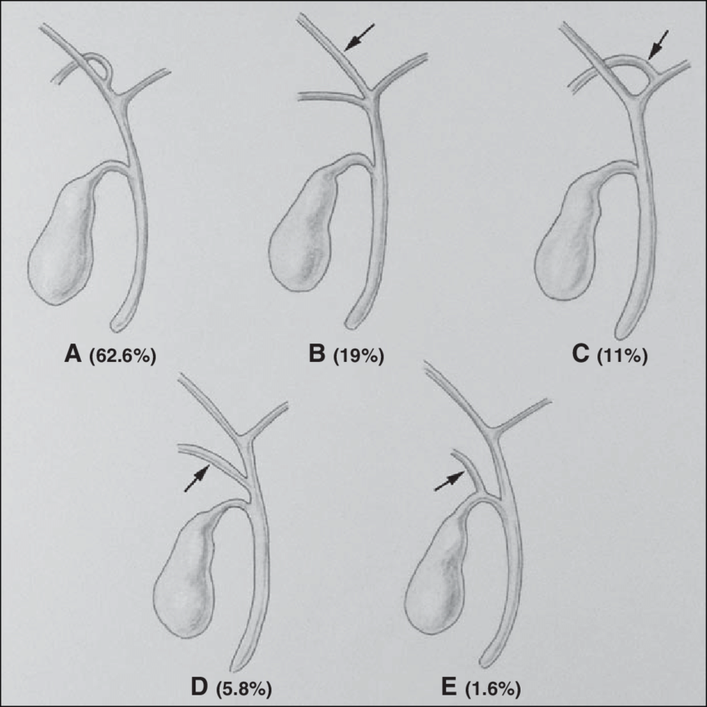
Who gets them?
No age or gender predilection
Only obvious risk factor is presence of an accessory or anomalous bile duct
https://www.ncbi.nlm.nih.gov/pmc/articles/PMC3557131/#:~:text=Significant%20postoperative%20bile%20leak%20may,accessory%20or%20anomalous%20bile%20duct.
Santiago, Inês & Loureiro, Rui & Curvo-Semedo, Luís & Marques, Cristina & Tardáguila, Francisco & Matos, Celso & Caseiro-Alves, Filipe. (2012). Congenital Cystic Lesions of the Biliary Tree. AJR. American journal of roentgenology. 198. 825-35. 10.2214/AJR.11.7294.

Slide 4
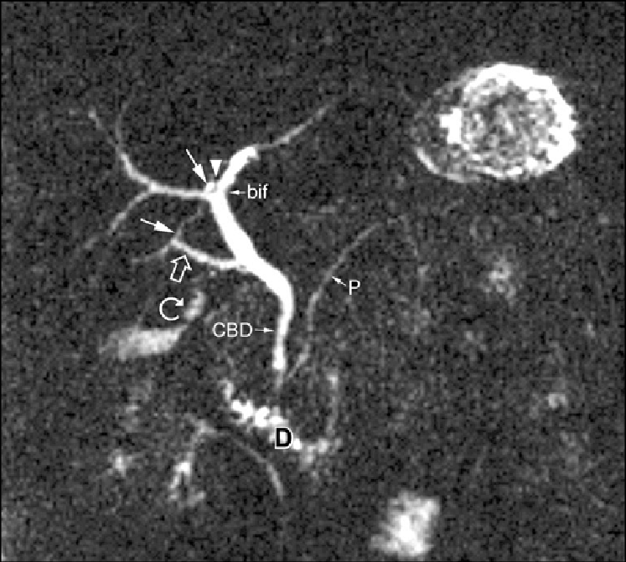
Anomalous Duct Example
“Coronal thickslab MR cholangiopancreatography reveals dorsocaudal branch of right hepatic duct (arrows) draining into left hepatic duct (arrowhead). Aberrant right hepatic duct (open arrow) drains into common hepatic duct. Common bile duct (CBD), cystic duct (curved arrow), pancreatic duct (P), duodenum (D), and biliary bifurcation (bif) are noted.”
Santiago, Inês & Loureiro, Rui & Curvo-Semedo, Luís & Marques, Cristina & Tardáguila, Francisco & Matos, Celso & Caseiro-Alves, Filipe. (2012). Congenital Cystic Lesions of the Biliary Tree. AJR. American journal of roentgenology. 198. 825-35. 10.2214/AJR.11.7294.

Slide 5
Clinical Manifestations?
Persistent abdominal tenderness, generalized malaise, anorexia (nonspecific)
Interestingly: “Bile leak after surgery resulting in intraperitoneal bile collection is typically not contaminated by bacteria and usually does not result in severe bile peritonitis”
Timing: symptoms usually present within the first week but may present up to 30 days following the operation

Slide 6
How is it Diagnosed?
Bile duct injury can be ID’d intraop
Ultrasound can usually confirm
CT imaging if desired (can show biloma)
ERCP can both delineate site of leak AND be therapeutic
“ERCP image obtained in a 58-year-old man with abdominal pain after laparoscopic cholecystectomy demonstrates bile leakage from the cystic duct stump (arrow)”
Thompson, Colin & Saad, Nael & Quazi, Rehnuma & Darcy, Mike & Picus, Daniel & Menias, Christine. (2013). Management of Iatrogenic Bile Duct Injuries: Role of the Interventional Radiologist. Radiographics : a review publication of the Radiological Society of North America, Inc. 33. 117-34. 10.1148/rg.331125044.

Slide 7
Biloma CT
Imaging findings typically include:
Bile collection in gallbladder fossa
Small connection with the cystic duct remnant usually visible on MRCP
https://www.ncbi.nlm.nih.gov/pmc/articles/PMC3557131/#:~:text=Significant%20postoperative%20bile%20leak%20may,accessory%20or%20anomalous%20bile%20duct.
Weerakkody, Y., Jones, J. Biloma. Reference article, Radiopaedia.org. (accessed on 16 Mar 2022) https://doi.org/10.53347/rID-9840

Slide 8
Where is the leak?
68% from cystic duct remnant/stump
17% from ducts of Luschka
15% other
“Cystic duct leaks occur due to varying combinations of clip dysfunction or misplacement and necrosis or tearing of the cystic duct remnant proximal to the clip”

Slide 9
Classification
ERCP, Bismuth, and Strasberg

Slide 10
Bile Leak Grading
High Grade Leaks
Low Grade Leaks
On ERCP, rapid extravasation of contrast on initial injection
Negligible intrahepatic filling prior to extravasation
Complete or near complete intrahepatic filling of contrast before extravasation

Slide 11
Bismuth and Strasberg Classification
https://www.ncbi.nlm.nih.gov/pmc/articles/PMC3557131/#:~:text=Significant%20postoperative%20bile%20leak%20may,accessory%20or%20anomalous%20bile%20duct.

Slide 12
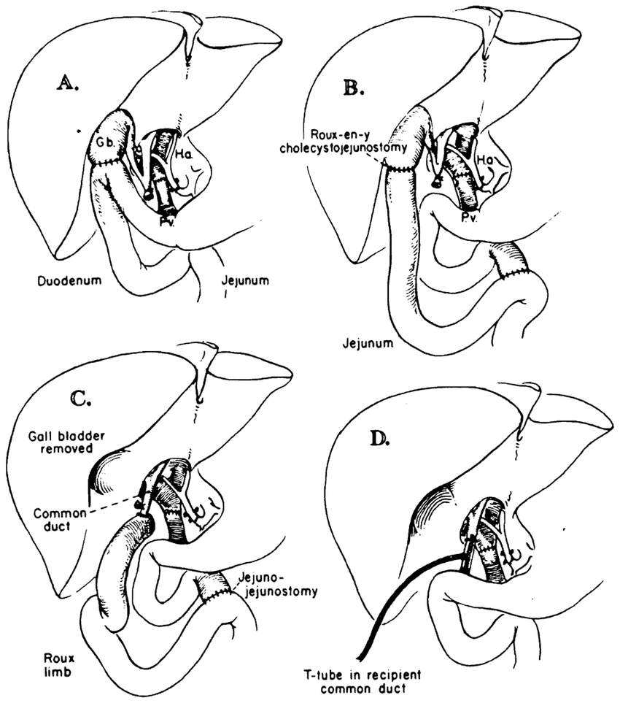
How is it treated?
WITHOUT Significant Major Duct Injury
WITH Significant Major Duct Injury
Percutaneous drainage of biloma
ERCP with sphincterotomy
Temporary stent placement
Surgical biliary reconstruction
Putnam, Charles & Halgrimson, Charles & Koep, Lawrence & Starzl, Thomas. (1977). Progress in Liver Transplantation. World journal of surgery. 2. 165-75. 10.1007/BF01665073.

Slide 13
What are the outcomes?
Minor bile leaks (small ones, from cystic duct stump or duct of Luschka) tend to resolve spontaneously
Up to 10% of patients with leak but without bile duct injury may not respond to initial ERCP therapy and require more extensive workup and surgery. This can often imply aberrant right hepatic duct
“Patients with a bile leak were more likely to die at one year (2.4 versus 1.4 percent; odds ratio 1.85; p <0.001). Similarly, patients with a bile duct injury had an increased one-year mortality (7.2 versus 1.3 percent; odds ratio 2.04; p <0.0001).”
https://www-uptodate-com.ezproxy1.library.arizona.edu/contents/complications-of-laparoscopic-cholecystectomy?sectionName=DIAGNOSIS%20AND%20MANAGEMENT%20OF%20BILIARY%20INJURIES&search=bile%20duct%20leak&topicRef=637&anchor=H10&source=see_link#H10

