Slide 1
Appendicitis
Leigh Myles, MS3

Slide 2
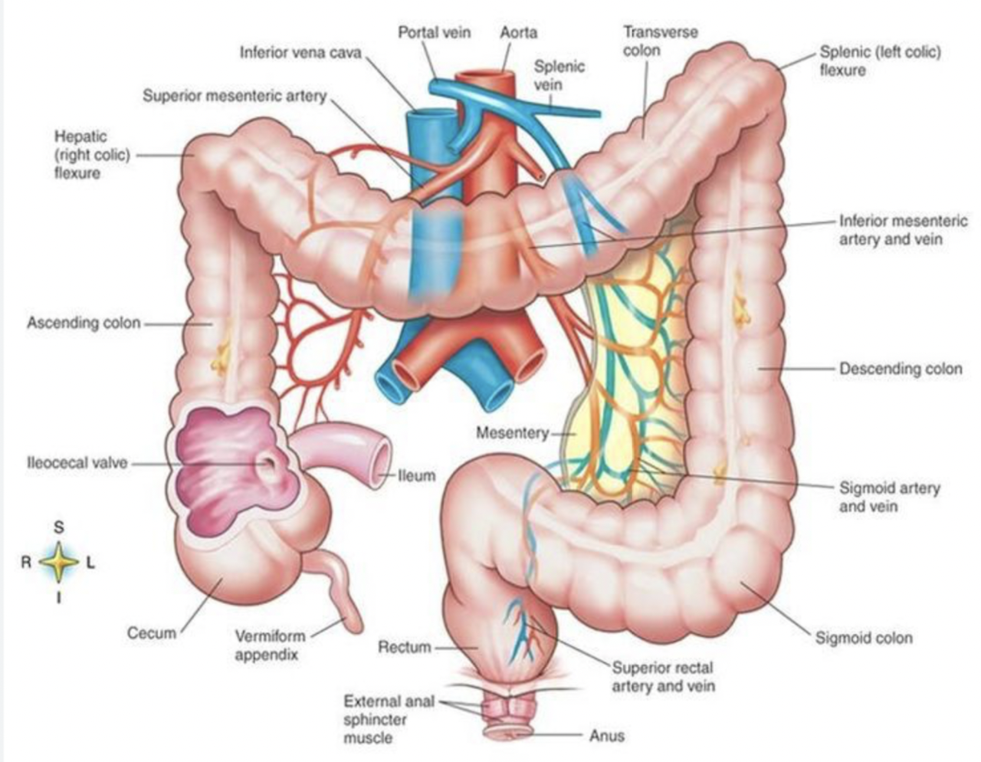
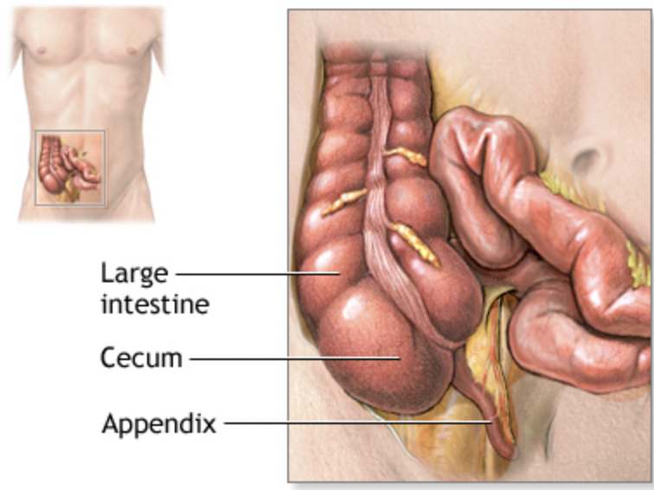
The Appendix
The appendix lies at the bottom of the cecum, at the junction of the terminal ileum and ascending colon. Apx 2-4 inches (5-10 cm) long
When you are a child, your appendix is a working part of your immune system, which helps your body to fight disease. When you are older, your appendix stops doing this and other parts of your body keep helping to fight infection.

Slide 3
How to locate the appendix on physical exam:

Slide 4
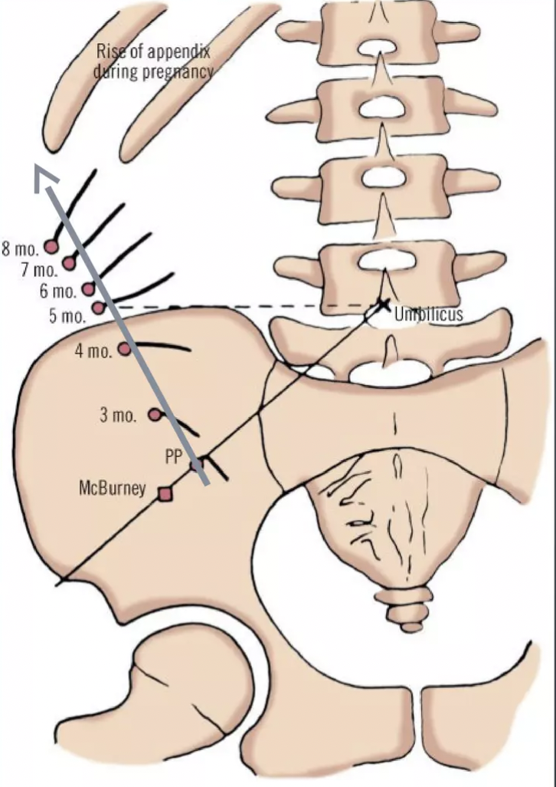
Places the appendix can hide:

Slide 5
Innervation & Nearby Anatomy:
The autonomic innervation of the appendix arises from the superior mesenteric plexus. Afferent sensory fibers from the appendix are carried on the sympathetic nerve fibers to enter the spinal cord at T10 which corresponds to the umbilical dermatome.

Slide 6
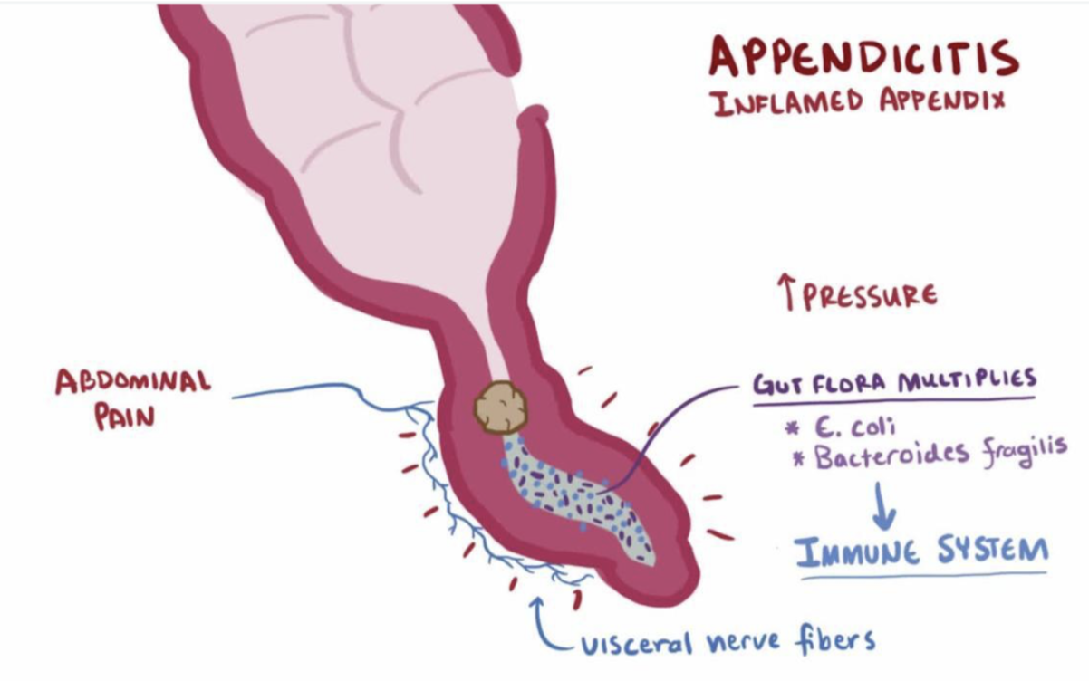
What is appendicitis?
Appendicitis is inflammation of the appendix, it occurs when the appendix becomes inflamed and filled with pus. It occurs when the inside of the appendix is blocked. Can be caused by various infections such as virus, bacteria, or parasites, in the digestive tract.
Appendicitis can also happen when the tube that joins your large intestine and appendix is blocked or trapped by stool. Tumors can also cause appendicitis.
The appendix becomes sore and swollen. The blood supply to the appendix stops as the swelling and soreness get worse. Without adequate blood flow, the appendix will begin to necrose and can perforate, allowing stool, mucus, and infection to leak through, resulting in peritonitis.
Appendicitis occurs in 7% of the US population, with an incidence of 1.1 cases per 1000 people per year.
Appendicitis is the most common surgical issue in the pediatric population. It presents in 19–28 per 10,000 children younger than the age of 14 and is diagnosed in 1 in 8 children evaluated urgently for abdominal pain

Slide 7
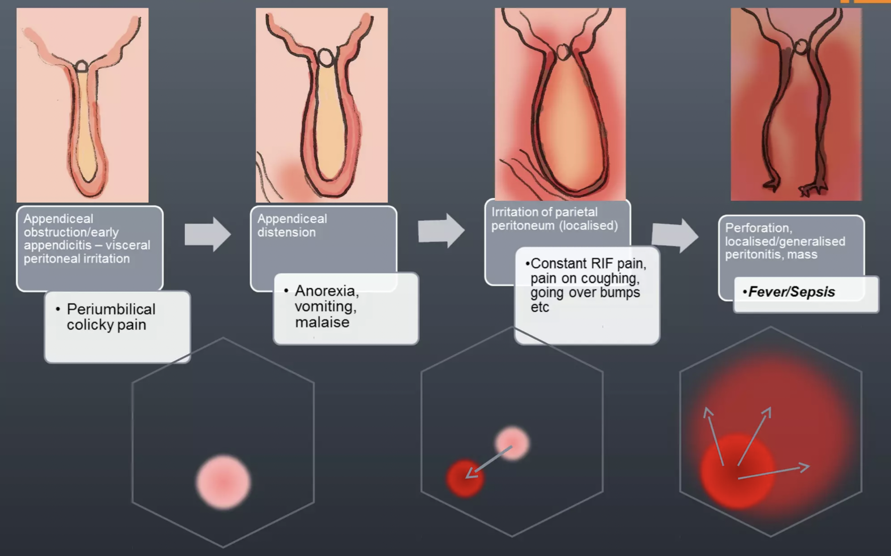
Clinical Symptoms of Appendicitis:
Early: Dull, colicky periumbilical (T10) pain; vomiting, anorexia.
Later appendicitis: constant pain localized to R iliac fossa, aggravated by coughing/going over bumps, relieved by hip flexion & stillness. Peritonitis w/ guarding, rebound tenderness, tenderness to percussion. Rovsing & Psoas signs.
Late findings: constant, diffuse, severe lower abdominal pain, aggravated by movement, palpation, rebound (peritonitis). Systemic features: fever, tachycardia, hypotension.

Slide 8
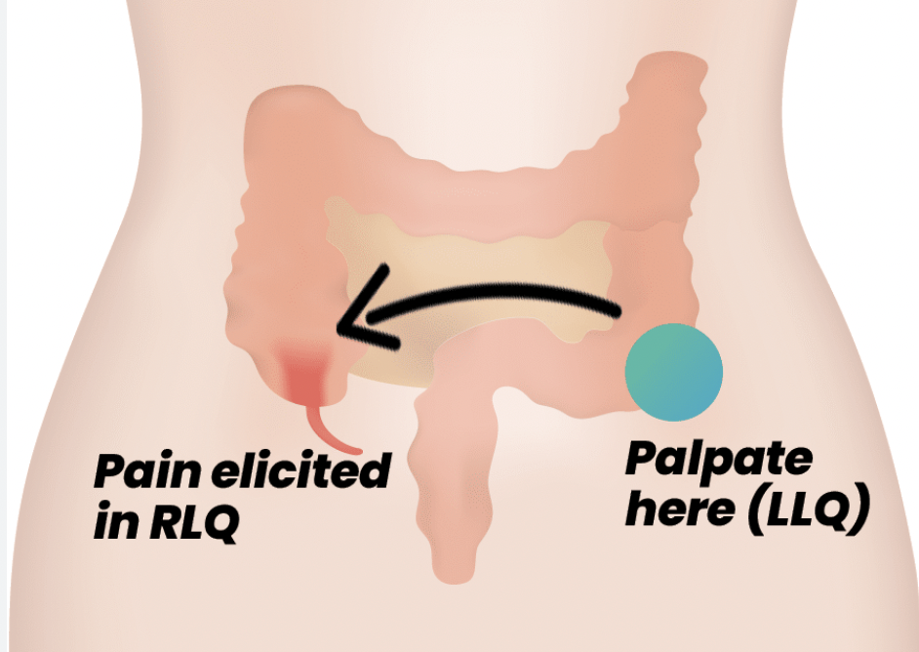
Positive McBurney’s, Rovsing, Psoas & Obturator signs:
Positive McBurney’s Sign: significant pain elicited by palpating McBurney’s Point
Rovsing Sign: Right Iliac Fossa pain on palpation of Left Iliac Fossa
Psoas Sign: Pain on right hip extension (patient in left lateral decubitus position), indicates abscess posterior to appendix / adjacent to psoas muscle (can be unruptured retrocecal appendix, confirm w/ CT)
Obturator Sign: Pain on right hip/knee flexion with rotation

Slide 9
Common Lab Values of Appendicitis:
Laboratory measurements such as leucocyte count, neutrophil percentage and C-reactive protein (CRP) concentration are commonly used as diagnostic aids in patients with suspected acute appendicitis.
Rise in leucocyte count and neutrophil percentage is often correlated with the degree of appendiceal inflammation. Median CRP levels are often much higher in patients with ruptured appendicitis compared to patients with a normal appendix.

Slide 10
Management of Appendicitis:

Slide 11
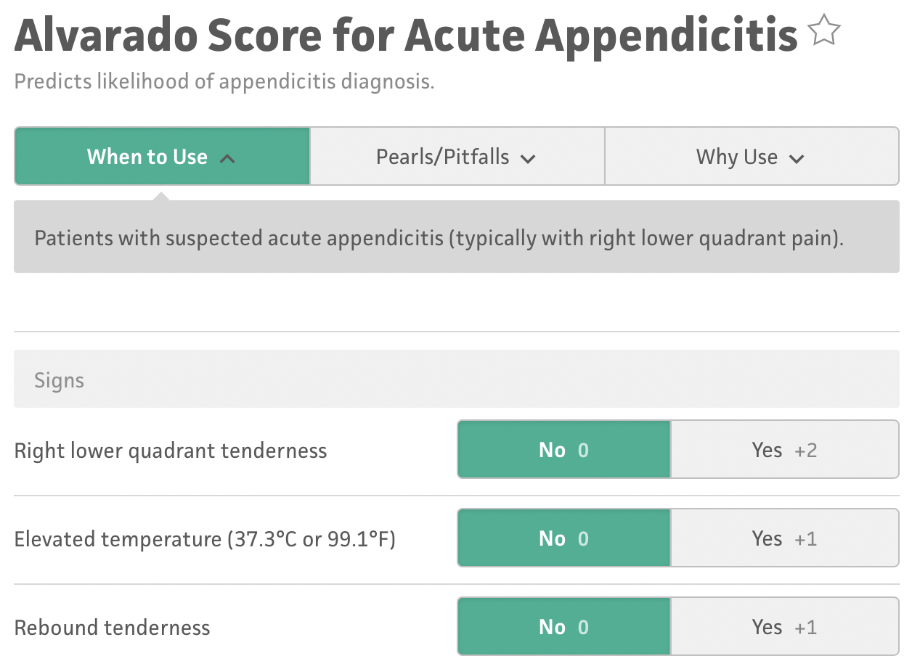
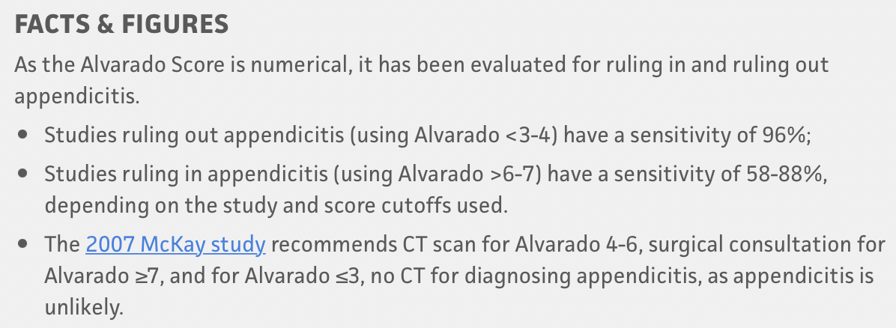
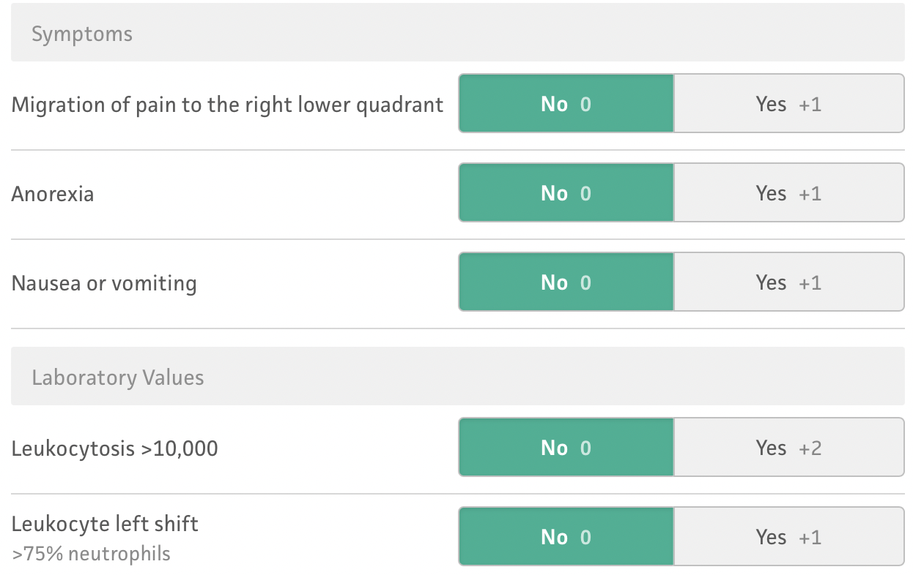
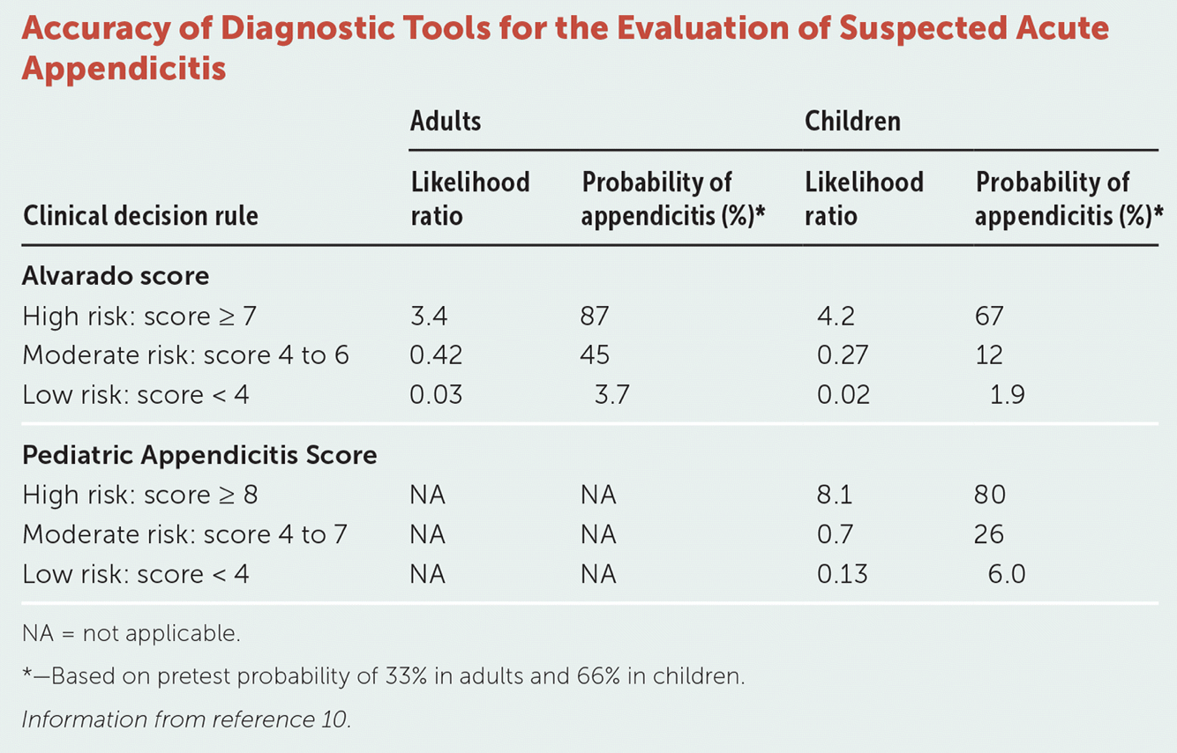
Alvarado Scoring:

Slide 12
Appendicitis Complications:
Rupture & Sepsis
I&D with appendectomy. IV antibiotics.
Periappendaceal Abscess
High complication rate with immediate surgery of contained appendiceal abscess due to inflamed, infected, and friable debris and adhesions. If clinically stable, treat with IV antibiotics, bowel rest, possible percutaneous abscess drainage. Return in 6-8 weeks for elective appendectomy (“interval appendectomy”).
Bronchoperitoneal fistula leading to hypoxic respiratory failure
Death

Slide 13
Bronchoperitoneal fistula leading to hypoxic respiratory failure:
Very rare: A PubMed search of bronchoperitoneal fistula resulted in only 6 unique case reports and only one case in 1947 that was secondary to appendicitis (Journal of Pediatric Case Reports, 2022).
Chief Complaint: difficulty breathing

Slide 14
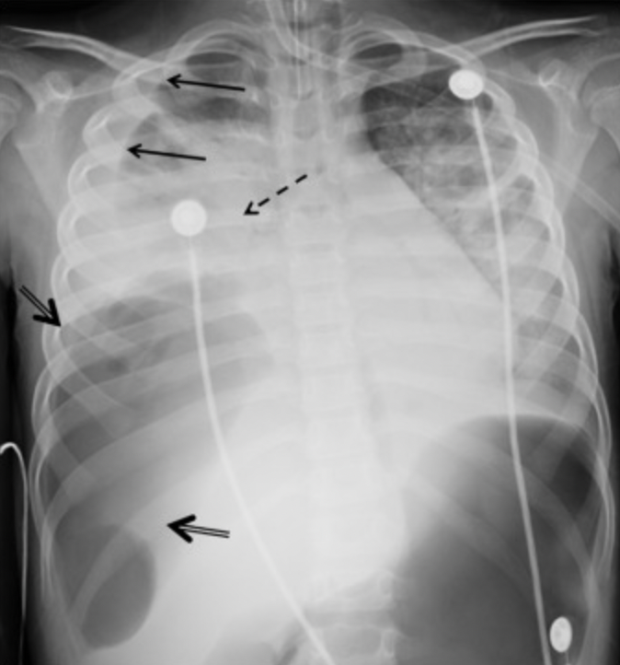
Bronchoperitoneal Fistula:
chest x-ray & non-contrast CT of the chest, abdomen, and pelvis: subphrenic abscess that necessitates through the diaphragm into the pleural space + signs of perforated appendicitis.
large right pleural effusion layering to the apex (black arrows), consolidation of the lower lobes (black dashed arrows) with silhouetting of the right hemidiaphgram, and large collection of air at the interface of the right hemidiaphgram and right lower chest (black double arrow)

Slide 15
Summary:
Appendicitis occurs in 7% of adult US population and is the most common pediatric surgical emergency.
Early detection of appendicitis can prevent life-threatening complications and death.

Slide 16
Questions?

Slide 17
References:
https://www.sciencedirect.com/science/article/pii/S2213576622000501
https://www.slideshare.net/ArmaanSingh786/acute-appendicitis-44732084?qid=66134027-9557-4507-9424-de11c0986606&v=&b=&from_search=23

