Slide 1
Amputation
Alexis Johnson

Slide 2
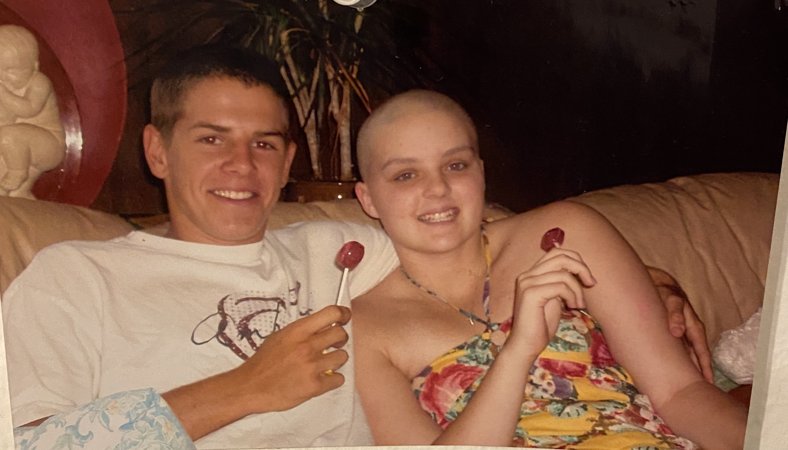

Slide 3
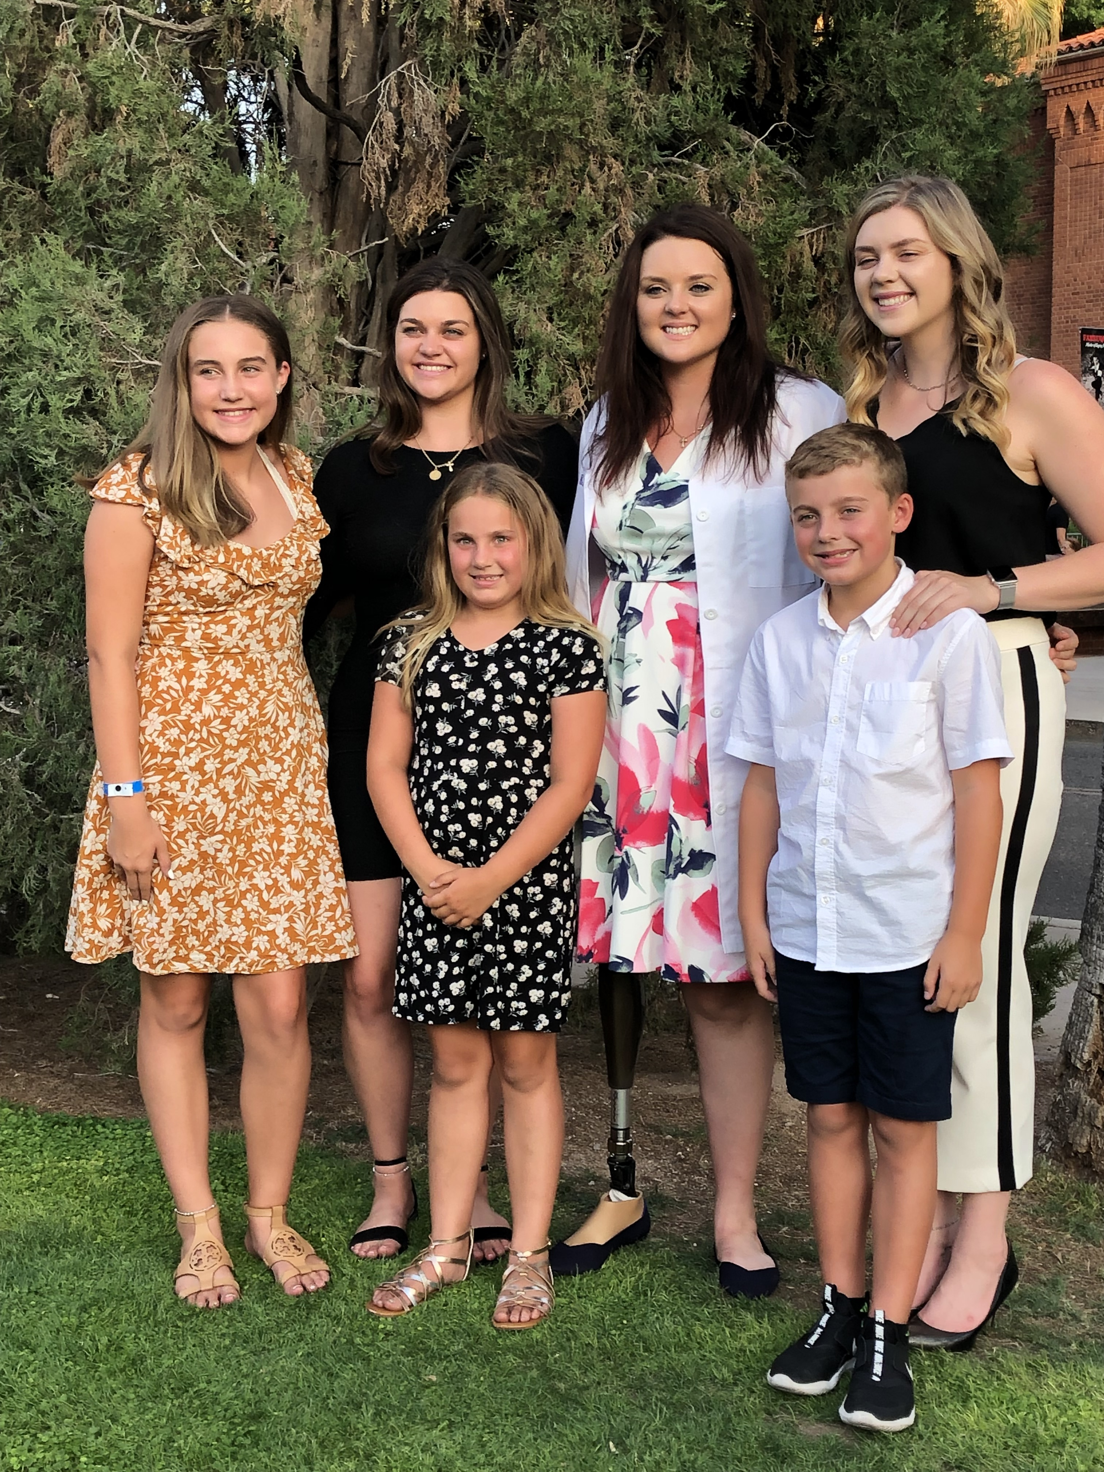
Statistics
Nearly 2 million people living with limb loss in the United States
-Male: 70%
-Female:30%
Younger <50 Trauma
Over 50 years: Peripheral vascular disease/ Diabetes
-Projected that the amputee population will more than double by the year 2050 to 3.6 million.
the estimated cost to American private & public insurance agencies is $12 billion annually. Lifetime healthcare costs for people with limb loss is $509,275
Notes:
https://accessprosthetics.com/15-limb-loss-statistics-may-surprise/

Slide 4
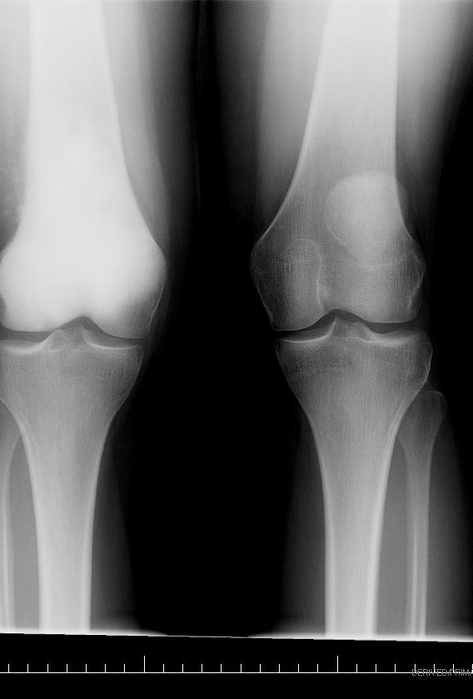
INdications
•
3 D’s
Dead or Dying: peripheral vascular disease, Diabetes ,severe trauma, burns or frostbite
Dangerous: Malignant tumors , lethal sepsis i.e. gas gangrene or possible crush syndrome
Dam Nuisance: Pain, gross malformation, severe loss of function, recurrent sepsis.

Slide 5
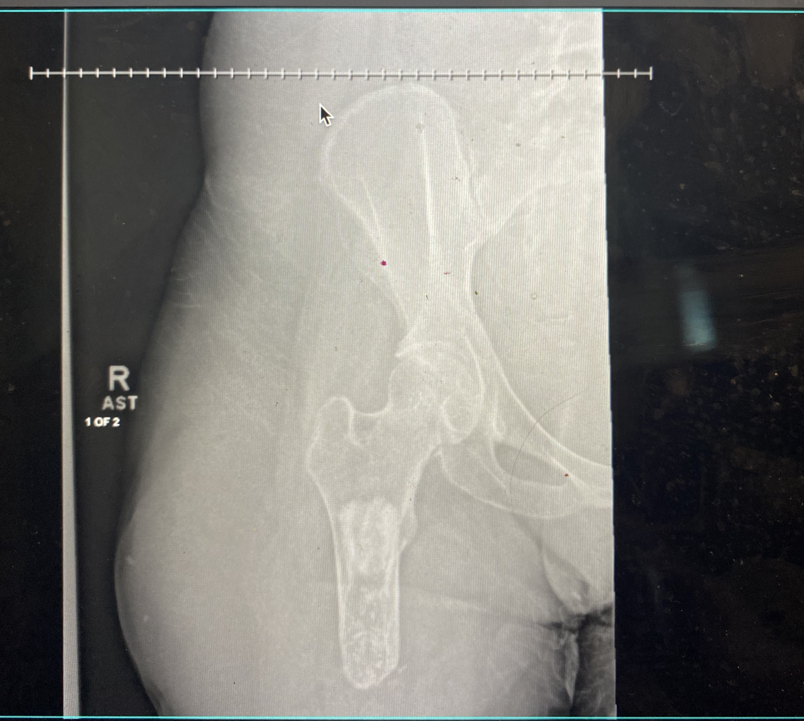
Pathophysiology
*Transtibial amputations the energy energy cost for a walk is not much greater for a person who has not undergone amputation; Mean Oxygen consumption increase by 9%
* Transfemoral amputations energy required is 50 to 60 % greater; mean oxygen consumption above-knee amputees at increases by 49%,
Notes:
https://www.ncbi.nlm.nih.gov/books/NBK546594/

Slide 6
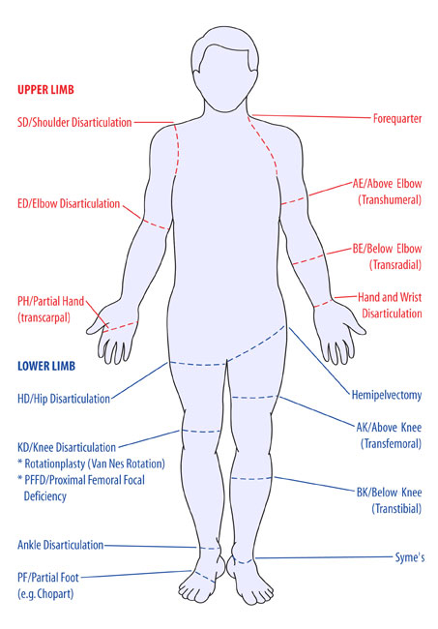
Surgery
-lower extremity functions as the patient’s foot, and as such, requires reconstructive design to provide a durable interface for walking and the transfer of body weight
General principles for amputation surgery involve appropriate management of :
Skin: . Flaps should be broad based, More skin surface for contact for pressure
Bone: Managing the edges of severed bone is essential to pain-free healing, and the sharp cortical bone edges/ irregularities should be carefully contoured and rounded.
Muscles : Different types: simple myofascial closure, myoplasty , myodesis and tenodesis.( depends on the patient)
Nerves: When a nerve is severed in the amputation process, the surgeon’s goal is to position the nerve ending in a well-cushioned soft tissue site away from the incision and any scar tissue
Vessels: Adequate blood supply to tissues /homeostasis
-
Notes:
In myodesis, the deepest layers of muscle are typically secured directly to the bone, while the more superficial layers of muscle are sewn to each other as a myoplasty.
Skin can be hard if not healing right
Bone to avoid bone spurs
Wound healing, hematomas
Nuerofmas(. Tissue build up around the skin

Slide 7
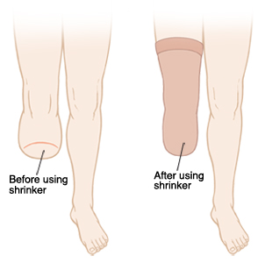
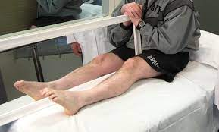
Post op management
Immediate Mangament:
Control edema/pain
Prevent contracture
Limb desensitization
Phantom limb pain & sensation(massage ,cold packs,mirror therapy)
Notes:
https://www.ncbi.nlm.nih.gov/books/NBK546594/
This involves massaging, rubbing, and tapping the end of your residual limb( desentization)

Slide 8
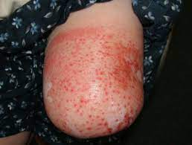
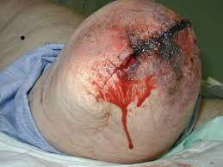
Short/ Long term complications
Short term complications
Wounds infection/Failure wound to close
Revisions of limb
Long term:
Depression/ Anxiety : depression can occur in 20.6 to 63% of patients and anxiety in 25% to 57%
Chronic Skin breakdown

Slide 9
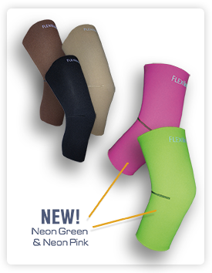
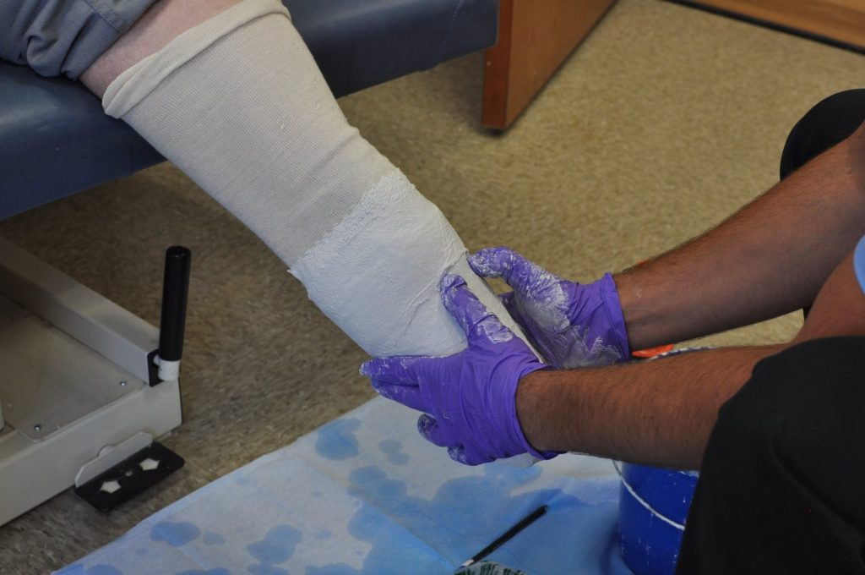
Types of prosthetics
1. Socket; matches the size and shape of residual limb
2. Different types of suspension s:
Suction
Sleeve suction
Vacuum suspension/suction or distal
Locking through pin or lanyard.
Notes:
Limb changes ovetime, first year you go through a lot of sockets, limb can still change, edema

Slide 10
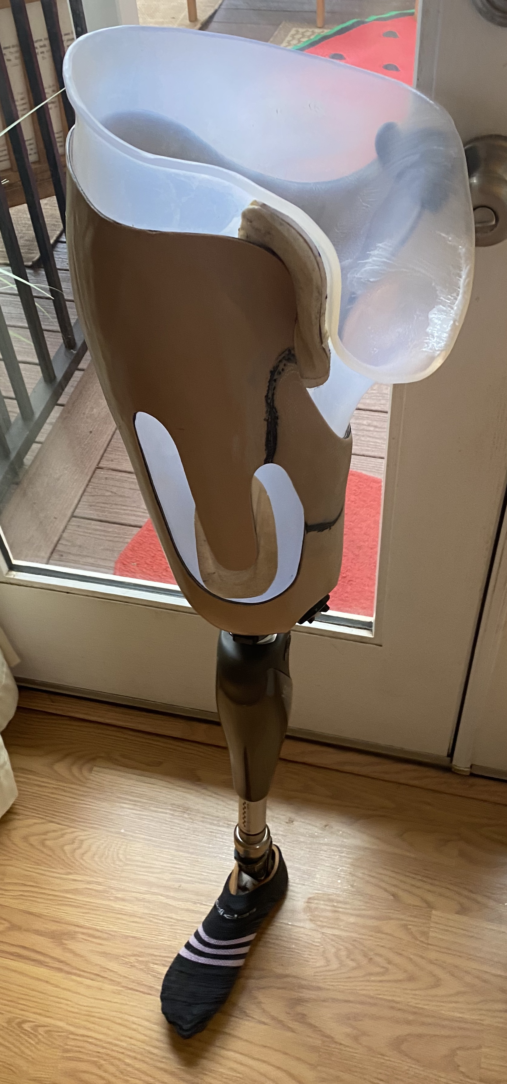
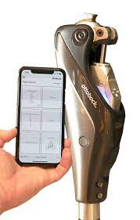
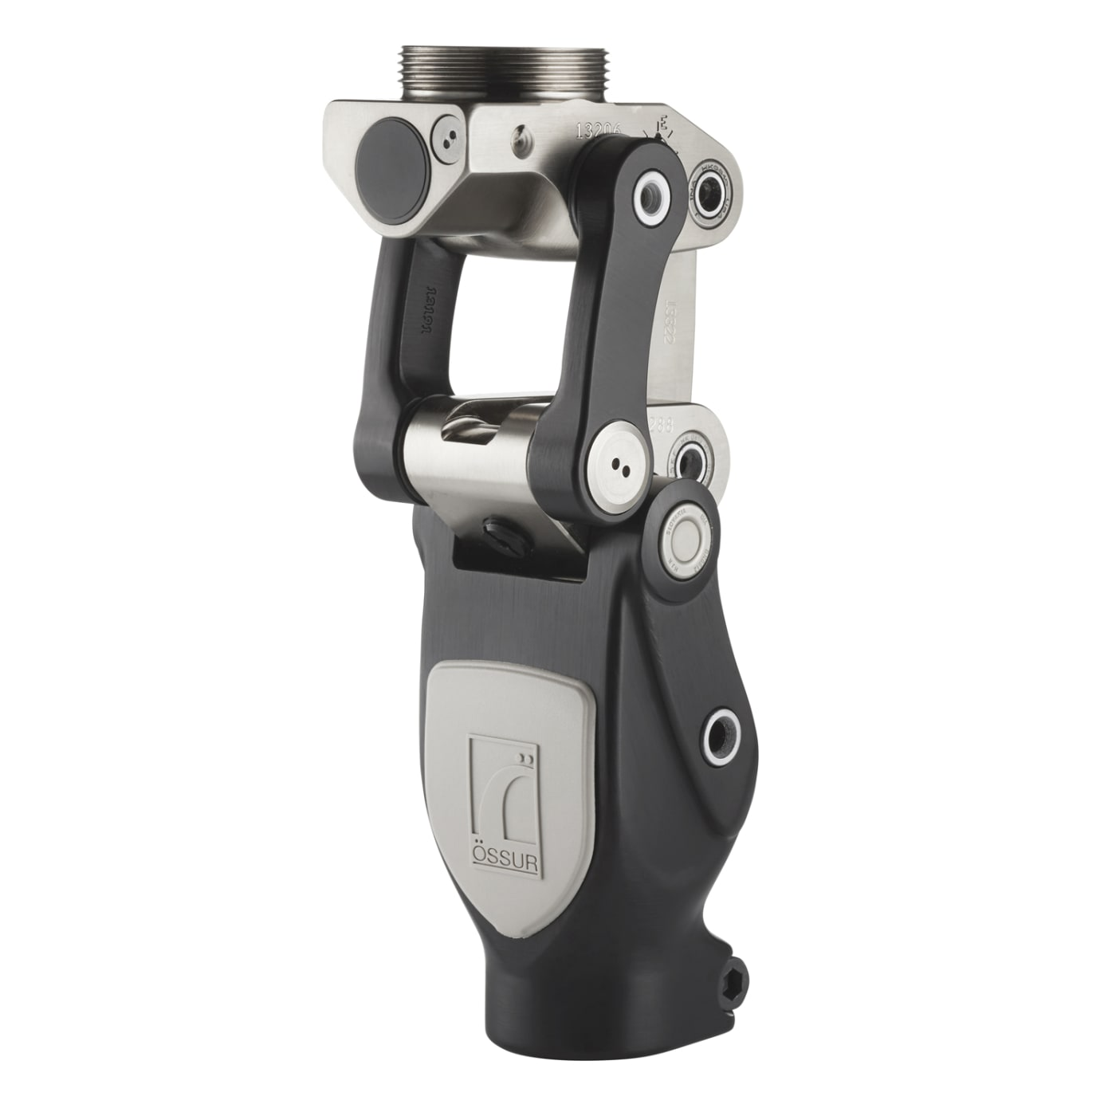
3. Knee Component:
Computerized
Mechanical Knees ( hinge) =hydraulic or locking mechanism)

Slide 11
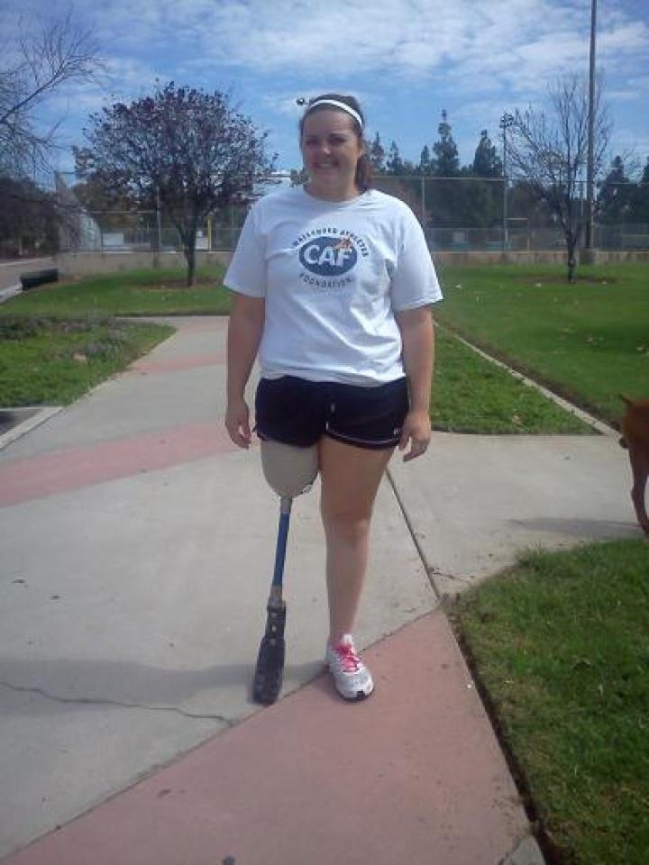
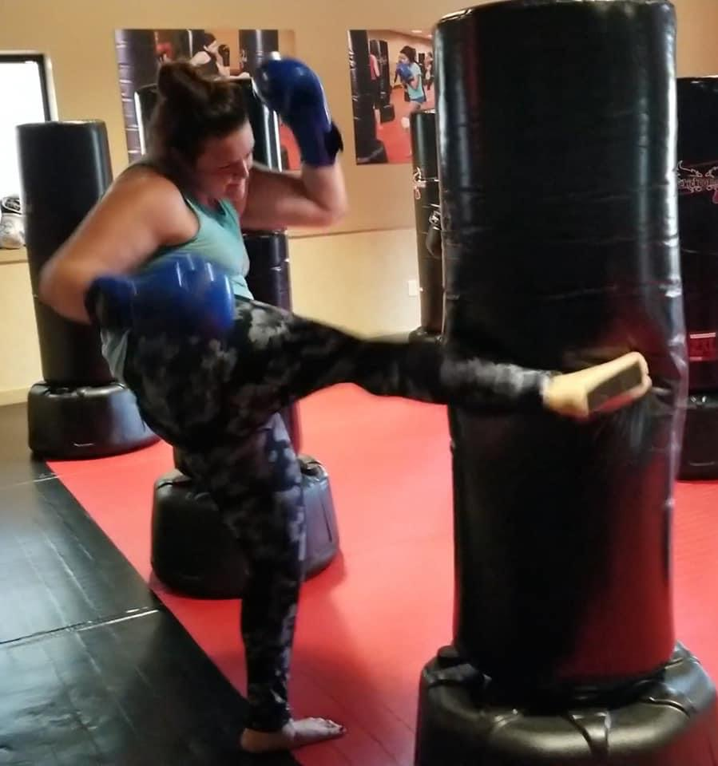

Slide 12
Osteointegration
An artificial implant is permanently, surgically anchored and integrated into bone, which then grows into the implant.
Pros:
improves mobility/ proprioception
reduces nerve pain
eliminates common problems associated with sockets
Cons:
implant loosening
fracture
Infection at stoma site
Notes:
Negative: implant loosening
fracture
infection
https://www.hss.edu/condition-list_osseointegration.asp
https://journals.lww.com/jbjsreviews/Fulltext/2017/10000/Osseointegration_for_Lower_Limb_Amputation__A.3.aspx
prospective cohort of 86 subjects using the Osseointegration Group of Australia Accelerated Protocol (OGAAP), the infection rate was 34%²⁵. ( have made new designs to the site and the type of metal to decrease in infection rate from 64 % to 34%

