Slide 1
Acute Appendicitis
Tyler Klee
University of Arizona College of Medicine

Slide 2
The Case
22 year old otherwise healthy female with 2 days of abdominal pain
Surgical history of tonsillectomy at age 9
No other PMHx, no medications, NKDA, unremarkable FHx
No tobacco use, occasional alcohol, no recreational drug use

Slide 3
Subjective
Abdominal pain started as dull and central, accompanied by nausea
No associated fever/chills or change in bowel habits, no vomiting
Initially continued to tolerate PO, but over the course of the day lost appetite and laid in bed with minimal intake

Slide 4
Subjective
Abdominal pain persisted throughout the night, gradually began to radiate to RLQ
Loss of appetite and nausea persisted, patient did not attempt to take in PO
Still no subjective fever but some chills

Slide 5
Objective
Eventually patient’s mother insists on taking patient to ED
Patient presents to ED and is found to be mildly hypertensive otherwise vitally stable but clearly uncomfortable
Physical exam by ED team notable for diffuse TTP

Slide 10
CT Abdomen/Pelvis with Contrast
Findings:
The appendix is significantly enlarged measuring up to 1.4 cm in diameter, with mucosal hyperenhancement.
Appendicoliths are present within the appendiceal lumen.
There is significant periappendiceal inflammatory stranding within the right lower quadrant.
There is a small volume of free fluid layering within the right lower quadrant and pelvis.
A small focus of pneumoperitoneum is also present.

Slide 11
CT Abdomen/Pelvis with Contrast
Impression:
Acute perforated appendicitis.
There is a small volume of free fluid layering in the right lower quadrant/pelvis, showing early signs of organization/abscess formation.
There were a few punctate foci of free air in the right pelvis.

Slide 12
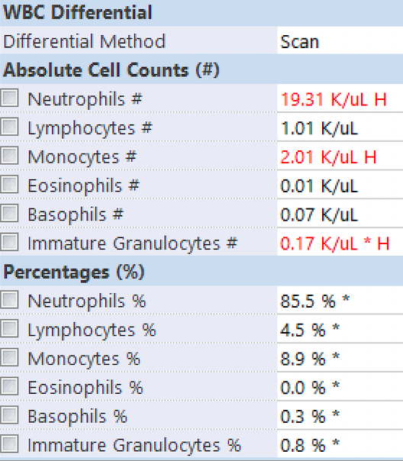
Labs

Slide 13
Labs

Slide 14
Labs

Slide 15
Surgery Consulted
Physical exam:
Diffuse TTP greatest in RLQ with rebound tenderness
+ Rovsing’s sign
+ Psoas sign
- Obturator sign

Slide 16
Rovsing’s sign: pain in the right lower quadrant after release of gentle pressure on left lower quadrant (normal position)
Obturator sign: pain with internal rotation of the hip (pelvic appendix)
Psoas sign: pain with flexion of the hip (retrocecal appendix)
Dahdaleh FS, Heidt D, Turaga KK. The Appendix. In: Brunicardi F, Andersen DK, Billiar TR, Dunn DL, Kao LS, Hunter JG, Matthews JB, Pollock RE. eds. Schwartz's Principles of Surgery, 11e. McGraw Hill; 2019. Accessed November 29, 2021. https://accessmedicine-mhmedical-com.ezproxy1.library.arizona.edu/content.aspx?bookid=2576&sectionid=216215350

Slide 17
Operative Findings
Diaphanous tissue attached to abdominal wall
Appendix deep in pelvis near uterus
Gangrene of appendix to 1cm from base
Fecalith outside of appendix but in close proximity
2 areas of perforation

Slide 18
POD #1
Patient doing well, pain controlled
Afebrile, vitals stable
Tolerating sips of water, no flatus/BM
Abdomen soft, diffuse TTP

Slide 19
POD #1
Continue IV ceftriaxone and metronidazole
Prevena wound vac to come down 48hr from placement
Removal of 1 inch packing strip when Prevena wound vac is removed
Pain control
Clear liquid diet

Slide 20
Acute Appendicitis - Numbers
Acute appendicitis
Most common emergency general surgical disease affecting the abdomen
Approximately 9% of men and 7% of women will experience an episode during their lifetime
Most commonly 10 to 19 years old
Approximately 20% of all patients will present with evidence of perforation
Appendiceal fecaliths (appendicoliths) are found in ~50% of patients with gangrenous appendicitis who perforate but are rarely identified in those who have uncomplicated appendicitis.

Slide 21
Acute Appendicitis - Presentation

Slide 22
Acute Appendicitis - Presentation

Slide 23
Acute Appendicitis - Presentation

Slide 24
Acute Appendicitis - Differential

Slide 25
Uncomplicated vs Complicated
The use of antibiotics to treat uncomplicated appendicitis is currently being studied, as many as 70% of patients who present with uncomplicated appendicitis based on computed tomography (CT) and who are treated with antibiotics alone will be free of recurrent disease for at least a year.
When perforation occurs, the resultant leak may be contained by the omentum or other surrounding tissues to form an abscess. Free perforation normally causes severe peritonitis.

Slide 26
Management
Patients who have strongly suggestive medical histories and physical examinations with supportive laboratory findings are candidates for appendectomy (open or laparoscopic)
A phlegmon or abscess → broad-spectrum ABx, drainage if abscess >3 cm in diameter, and IV fluids + bowel rest if responding. The appendix can then be more safely removed 6–12 weeks later when inflammation has diminished.

Slide 27
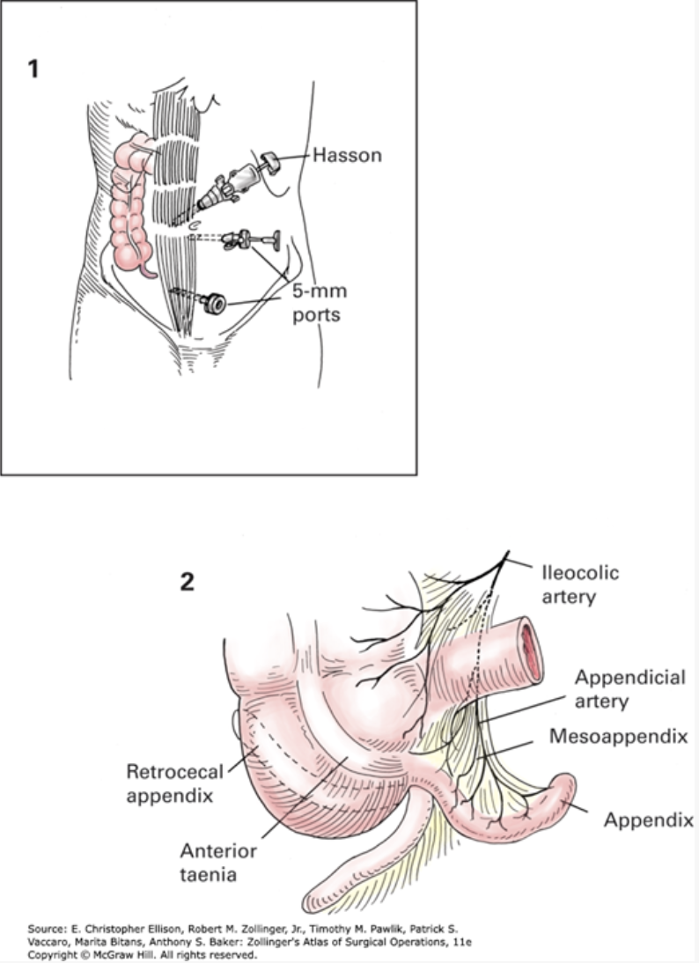
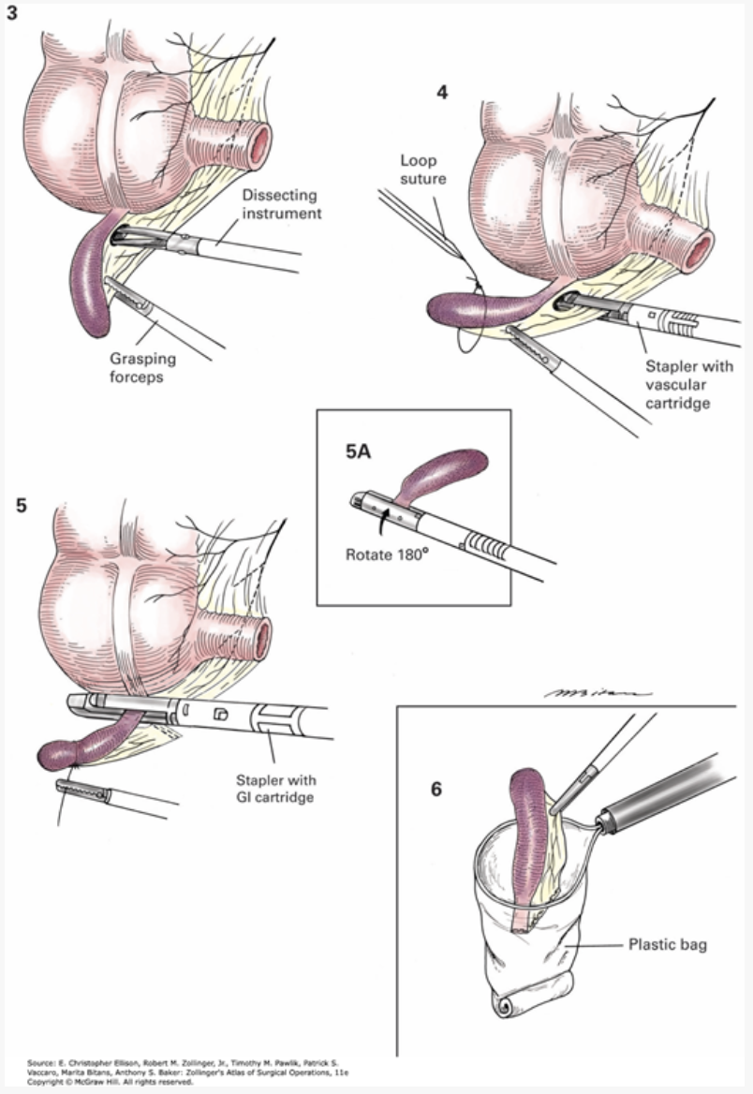
Notes:
Laparoscopic appendectomy

Slide 28
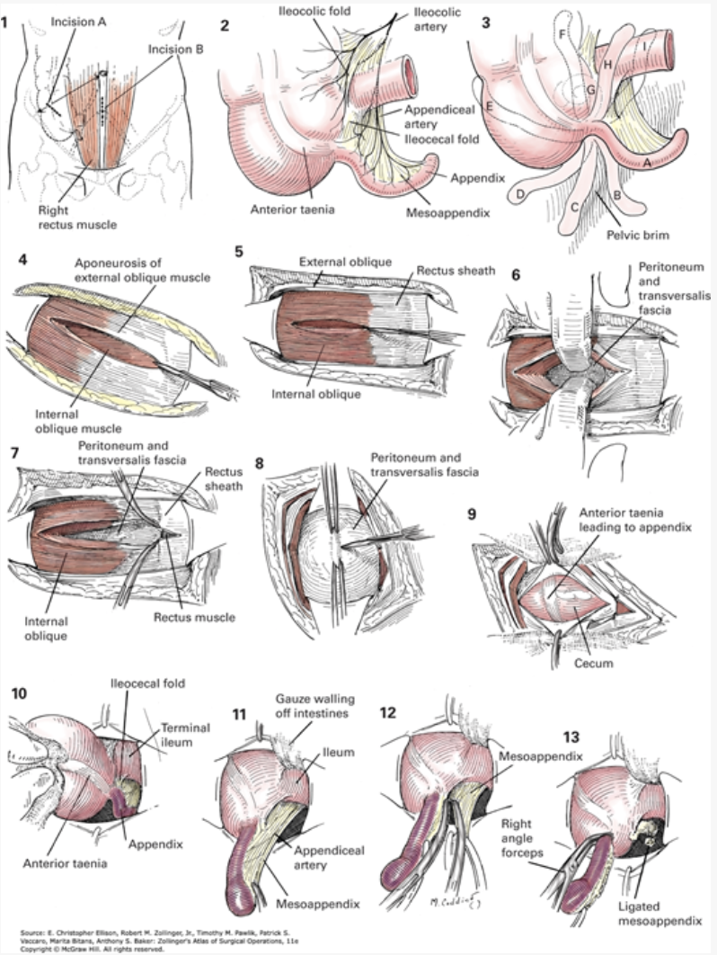
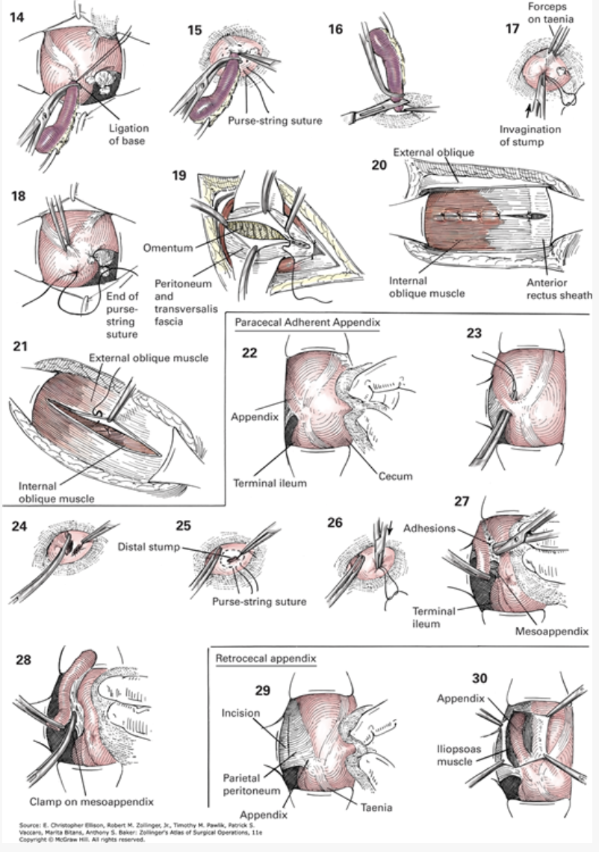
Notes:
Open appendectomy

Slide 29
Outcome
Most patients can be discharged within 24–40 h of operation.
The mortality rate for uncomplicated, nonperforated appendicitis is 0.1–0.5%, which approximates the overall risk of general anesthesia.
The mortality rate for perforated appendicitis or other complicated disease is much higher, ranging from 3% overall to a high as 15% in the elderly.

Slide 30
References
Dahdaleh FS, Heidt D, Turaga KK. The Appendix. In: Brunicardi F, Andersen DK, Billiar TR, Dunn DL, Kao LS, Hunter JG, Matthews JB, Pollock RE. eds. Schwartz's Principles of Surgery, 11e. McGraw Hill; 2019. Accessed November 29, 2021. https://accessmedicine-mhmedical-com.ezproxy1.library.arizona.edu/content.aspx?bookid=2576&sectionid=216215350
Jacobs DO. Acute Appendicitis and Peritonitis. In: Jameson J, Fauci AS, Kasper DL, Hauser SL, Longo DL, Loscalzo J. eds. Harrison's Principles of Internal Medicine, 20e. McGraw Hill; 2018. Accessed November 30, 2021. https://accessmedicine-mhmedical-com.ezproxy1.library.arizona.edu/content.aspx?bookid=2129&sectionid=192282881
Appendectomy. In: Ellison E, Zollinger, Jr. RM, Pawlik TM, Vaccaro PS, Bitans M, Baker AS. eds. Zollinger’s Atlas of Surgical Operations, 11e. McGraw Hill; 2022. Accessed November 30, 2021. https://accesssurgery-mhmedical-com.ezproxy3.library.arizona.edu/content.aspx?bookid=3101&sectionid=260093695

