Slide 1
Cholecystitis, Acalculous

Slide 2
Acalculous Cholecystitis
Inflammatory disease of the gallbladder without gallstones or cystic duct obstruction
1844 J. Duncan as a fatal complication following surgery for an incarcerated femoral hernia

Slide 3
Pathophysiology
Endothelial injury, gallbladder ischemia, and bile stasis
Bile stasis leads to local inflammatory response via chemical irritation
Risk Factors:
Severe illness- sepsis, HF, burns, dehydration, severe trauma
Impair ability to perfuse
Infection- hepatitis, HIV
Induce inflammatory response
TPN
Decreased CCK release
Pregnancy
Impaired smooth muscle motility

Slide 4
Epidemiology
5-10% of all acute cholecystitis cases
More common in males 9:2
Bimodal distribution in 4th and 8th decades of life
Seen in critically ill patients
Sepsis, burns, AIDS, TPN longer than 3 months
Post Surgery
0.9% patients following open abdominal aortic reconstruction
0.5% patients following cardiac surgery
4% patients following bone marrow transplant
In outpatient cases, 72% of patients demonstrated vascular disease⁸

Slide 5
Symptoms
Fever
Leukocytosis
Abdominal pain/discomfort
Jaundice- 20% of cases
Due to sepsis related cholestasis, biliary obstruction due to inflammation
RUQ mass palpable on exam
Elevated LFTs

Slide 6
Diagnosis
Clinical: critically ill patient with unexplained sepsis and jaundice, postoperative jaundice
Ultrasound: Sensitivity 80%, Specificity 99%
distended gallbladder > 5mm
thickened gallbladder walls > 3-4 mm
+/- pericholecystic fluid
Cholescintigraphy: Sensitivity 67%, Specificity 100%
Used if diagnosis is unclear after ultrasound
Failure of gallbladder to opacify after 4hrs indicates inflammation

Slide 7
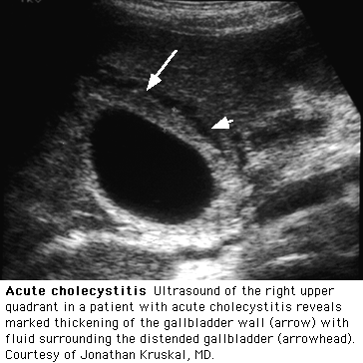
Diagnosis
4

Slide 8
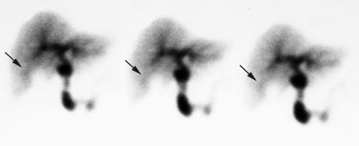
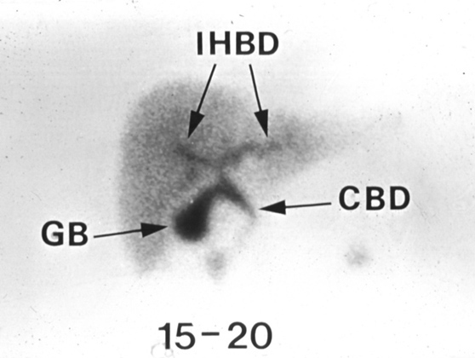
Diagnosis
Rim Sign⁵: increased pericholecystic hepatic activity w/o GB visualization
Increased flow or decreased excretion of tracer
20-30% cases of acute cholecystitis
Indicative of complicated cholecystitis with necrosis, perforation, or gangrene
Indication for emergent surgery

Slide 9
Morbidity & Mortality
 | AAC | ACC
Gangrene | 50% | 5.6%
Perforation | 10% | 4.8%
Mortality: due to sepsis w/multi-organ failure
Acute Acalculous Cholecystitis: 10-50%
W/o Treatment: 75%
W/Treatment: 30%
Traumatic: 90% with early cholecystectomy
Acute Calculus Cholecystitis: 1-3%

Slide 10
Treatment
High-Risk Surgical Candidates:
Antibiotics for secondary infection
Commonly enteric pathogens
Percutaneous cholecystostomy
Improvement usually in 24 hours, 2.7% recurrence rate
Endoscopic double pigtail stent placement using ERCP
Palliative treatment*
Blood cultures are done before antibiotic therapy²
Cholecystectomy

Slide 11
References
1. Afdhal, N. MD. Acalculous Cholecystitis. UpToDate. January 10, 2017.
2. Shojamenesh, H. MD, Roy, P MD. Acalculous Cholecystitis. Gastroenterology Medscape. 26 September 2016
3. Shojamenesh, H. MD, Roy, P MD. Acalculous Cholecystitis Treatment and Management. Gastroenterology Medscape. 26 September 2016
4. Williams, S. MD. Cholecystitis Scintigraphy. Image. 2001.
5. Zakko, SF, MD. Clinical Features and Diagnosis of Acute Cholecystitis. UpToDate. 9 November 2004
6. Davis, C.A. MD, Landercasper, J. MD, Gundersen, L. MD, et al. Effective Use of Percutaneous Cholecystostomy in High-Risk Surgical Patients. Techniques, Tube Management, and Results. JAMA. 1999; 134(7) 727-732.
7. Derici, H., Kara, C., Bozdag, A. Diagnosis and Treatment of Gallbladder Perforation. World Journal of Gastroenterology. 12(48) National Library of Medicine. National Institutes of Health. 2006.

