Slide 1
Abdominal Aortic Aneurysms
Madisyn Peru

Slide 2
Patient Presentation
Patient is a 68 year old male with a history of AAA s/p EVAR in October 2022 and HTN, who presented to clinic for continued growth of his aneurysm.
He initially presented in August 2024 and the aneurysm grew to 7.8 cm
He was scheduled September 26th for open repair but delayed because the patient was curious if stopping eliquis would slow the growth.
The patient returned for follow up in late October 2024, the aneurysm was now 10.1 cm in diameter.

Slide 3
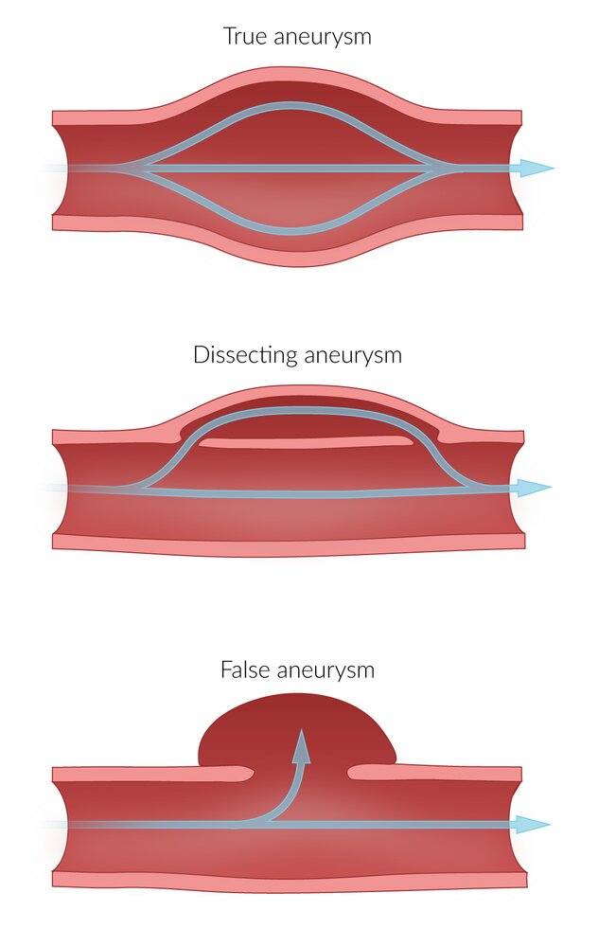
What is an abdominal aortic aneurysm?
Dilation of all three layers of the abdominal aorta - intima, media, and adventitia - greater than 3 centimeters in diameter

Slide 4
Epidemiology & Etiology
Peak incidence 60-70%
Rare in age < 50 years old
Male > Female - 2:1
Risk Factors?

Slide 5
Epidemiology & Etiology
Peak incidence 60-70%
Rare in age < 50 years old
Male > Female - 2:1
Risk Factors:
Smoking
Age
Atherosclerotic disease
Hypercholesterolemia
Arterial hypertension
Family history
Male sex
Trauma

Slide 6
Classifications
Location:
Infrarenal
Most common
~ 30% extend down to the iliacs
Suprarenal
Shape:
Saccular
Fusiform

Slide 7
Clinical Features?

Slide 8
Clinical Features
Pulsatile abdominal mass, at or above the umbilicus
Lower back pain
Bruit on auscultation
Peripheral thrombosis and distal atherosclerosis

Slide 9
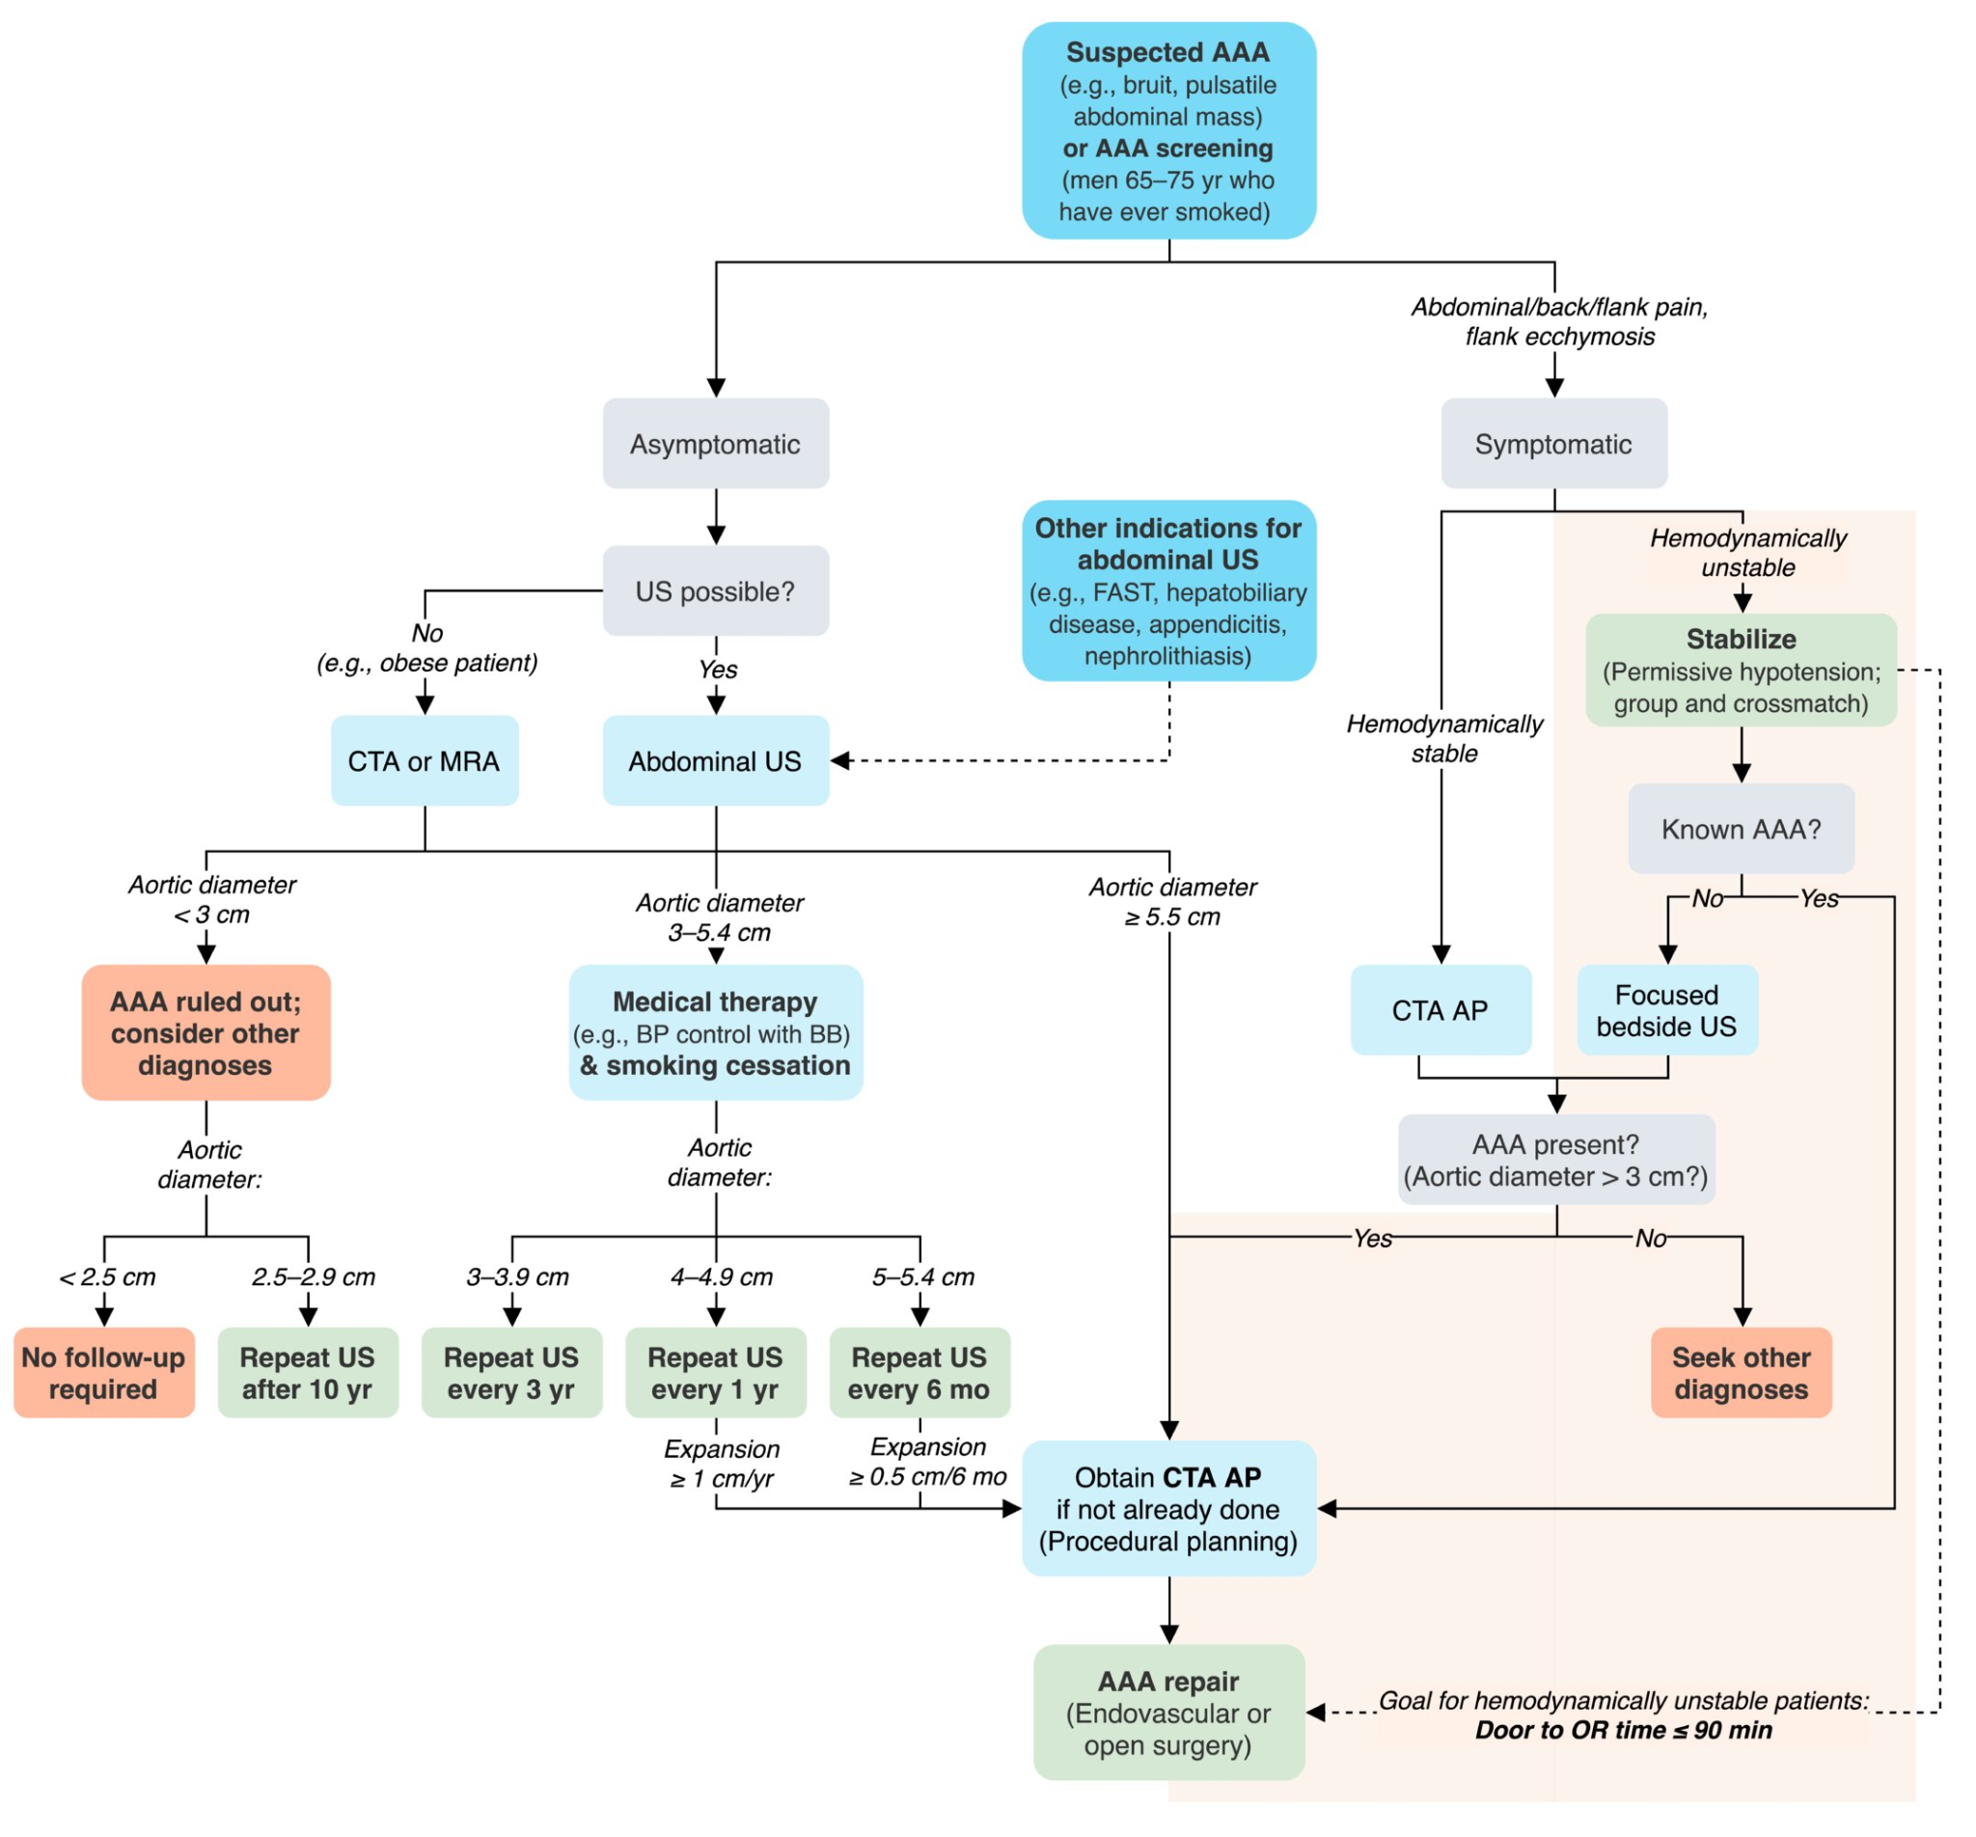
Diagnosis

Slide 10
Management
Emergency repair: Unstable patients
Urgent repair: impending rupture or leaking AAA
Indications for elective surgical repair?

Slide 11
Management
Emergency repair: Unstable patients
Urgent repair: impending rupture or leaking AAA
Elective surgical repair
Aneurysm > 5.5 cm in men. > 5.0 cm in women
Growth > 0.5cm in 6 months
Symptomatic aneurysm
Saccular aneurysm
Endovascular Aortic Repair
Minimally invasive
Open Repair
Mycotic aneurysm
Persistent endoleak following EVAR
Contraindication for EVAR

Slide 12
Conservative Management
Small (< 5.5 cm in men, < 5.0 cm in women), asymptomatic AAA can typically be observed with interval surveillance ultrasound.
To identify the expansion rate and thus decrease the risk of rupture
Frequency depends on the size of the aneurysm.

Slide 13
How was this patient managed?

Slide 14
Patient Case
Patient was scheduled, and underwent, an open abdominal aneurysm repair in early November.

