Slide 1
Management for Abdominal Aortic Aneurysm
Surgery Clerkship
Suranjana Rahman

Slide 2
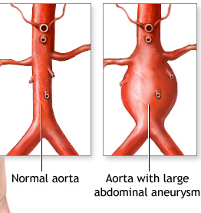
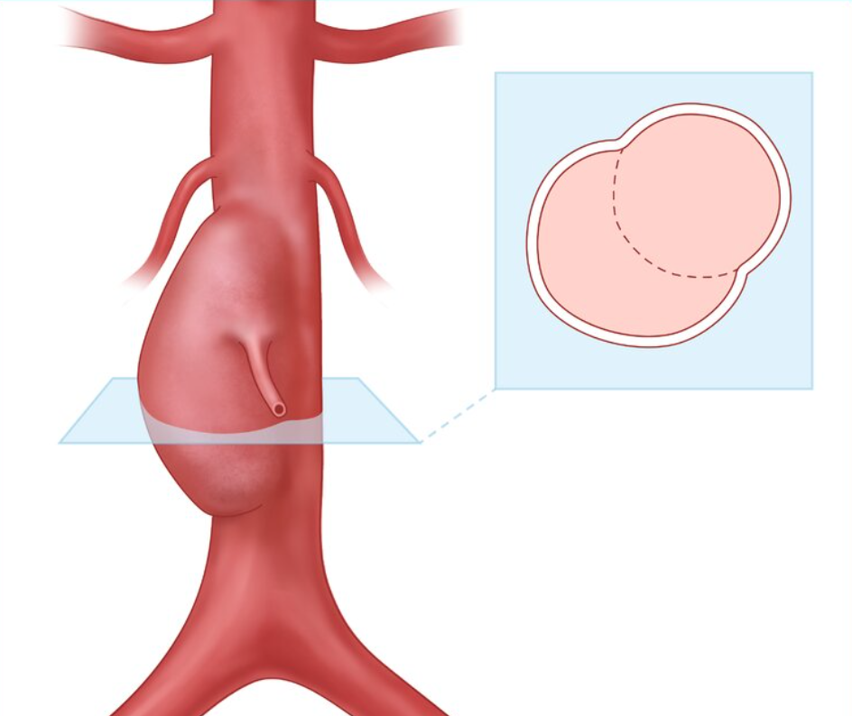
Indications for Repair
Diameter: ≥ 5.5 cm in men; ≥ 5.0 cm in women
Expansion rate: ≥ 0.5 cm/6 months
Saccular aneurysm unique shape predisposes to rupture
Complications (e.g. rupture)
Symptomatic aneurysm

Slide 3
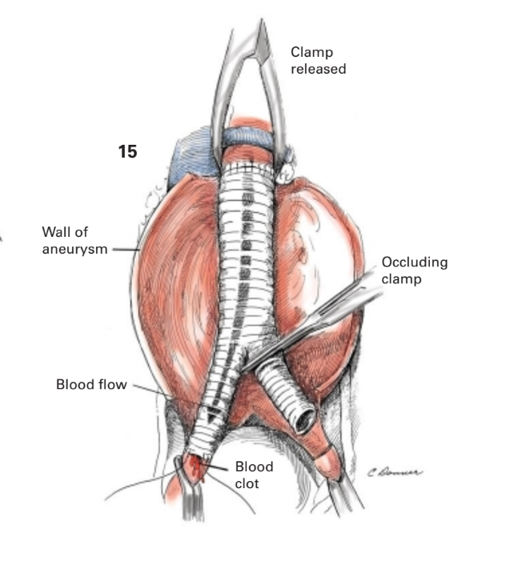
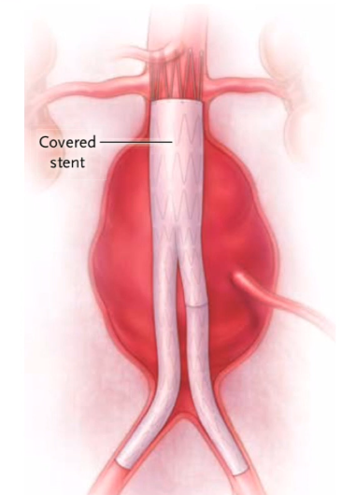
Options for Repair
Open Repair
Laparotomy
Stent-graft will be directly anastomosed to aorta and iliacs
Endovascular Aortic Repair (EVAR)
Catheter-guided
Dependent on aortograms throughout procedure
Stent-graft will be inserted through femoral artery access

Slide 4
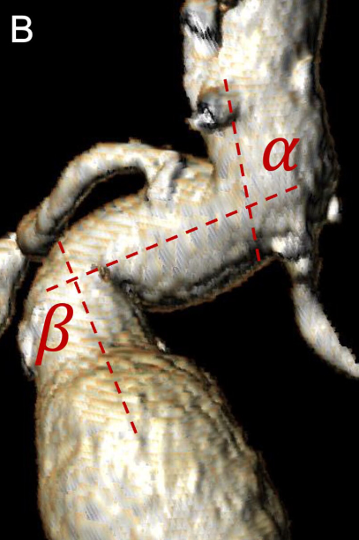
Indications and Limitations
Open Repair
Younger patient
Few medical comorbidities
Connective tissue disorder
long-term endovascular complications are inevitable
Anatomy not favorable for EVAR
highly angulated neck
Atherosclerosis of iliac arteries
Can extend graft and bypass the stenosis
Endovascular Aortic Repair (EVAR)
Older patient
Multiple medical comorbidities
Prior aortic surgery
previous surgical scarring can compromise the anatomy
Prior abdominal surgery
“Conventional thinking is that open repair is appropriate for young, healthy patients and
EVAR for older, sicker patients if they are anatomically suitable”
Moulakakis KG, Dalainas I, Kakisis J, Mylonas S, Liapis CD. Endovascular Treatment versus Open Repair for Abdominal Aortic Aneurysms: The Influence of Fitness in Decision Making. Int J Angiol. 2013 Mar;22(1):9-12. doi: 10.1055/s-0033-1333868. PMID: 24436578; PMCID: PMC3699226.

Slide 5
Outcomes and Complications
Open Repair
Associated with significantly lower 6-year mortality and rupture compared with EVAR
Higher rates of perioperative complications:
leg ischemia, intestinal ischemia
respiratory complications
nonhome discharge
Significantly higher odds of 30-day mortality
Spontaneous rupture/exsanguination
Spinal injury
Limb ischemia
Endovascular Aortic Repair (EVAR)
Higher rates of reintervention later in lifetime
Groin hematoma
Endoleak
persistent blood flow in the aneurysm sac
Late rupture (months after) 2/2 delayed endoleak presence
Spinal injury
Limb ischemia
Yei K, Mathlouthi A, Naazie I, Elsayed N, Clary B, Malas M. Long-term Outcomes Associated With Open vs Endovascular Abdominal Aortic Aneurysm Repair in a Medicare-Matched Database. JAMA Netw Open. 2022;5(5):e2212081. doi:10.1001/jamanetworkopen.2022.12081

