Slide 1

Management of a Retained Hemothorax
Kaxandra Nessi, MS3
University of Arizona College of Medicine - Tucson

Slide 2
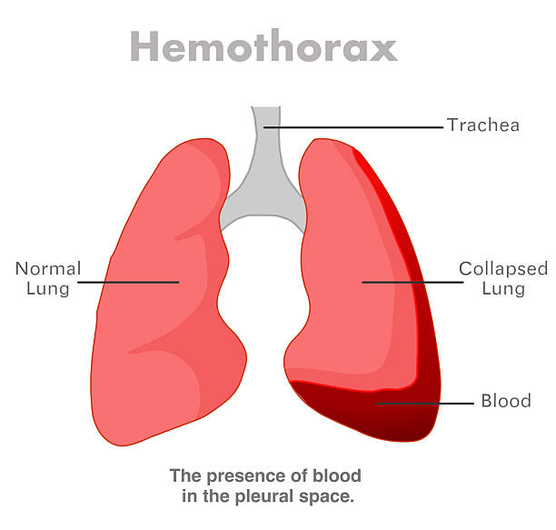
Hemothorax: Etiology & Epidemiology
Roughly 300,000 hemothoraces occur every year in the US, with an estimated 9.4% mortality rate. Causes include:
  Trauma (blunt and sharp)
    Blunt trauma is #1 most common cause
  Iatrogenic (surgeries to lung parenchyma, medications)
  Spontaneous (idiopathic, neoplasm rupture of vasculature)
Blood can originate from a variety of sources:
  Chest wall
  Intercostal vasculature
  Internal mammary arteries
  Great vessels
  Mediastinum
  Myocardium
  Lung parenchyma
  Diaphragm
  Abdomen

Slide 3
Classification: Severity & Time Course
The severity of hemothorax is classified according to amount of blood present in the pleural cavity:
Minimal hemothorax: <400 mL
Medium hemothorax: 400-1000 mL
Massive hemothorax: >1000 mL
Calculation:
Volume = depth² x height
A hemothorax can present in many ways, including:
Acute
  within hours after inciting event
Delayed
  within 24 hours after negative imaging OR within 44 days after initial presentation
    Rib fractures are most common cause of a delayed hemothorax
Retained
  Blood in ⅓ of pleural space that cannot be drained by thoracostomy after 72 hours OR clots of at least 500 mLs in volume

Slide 4
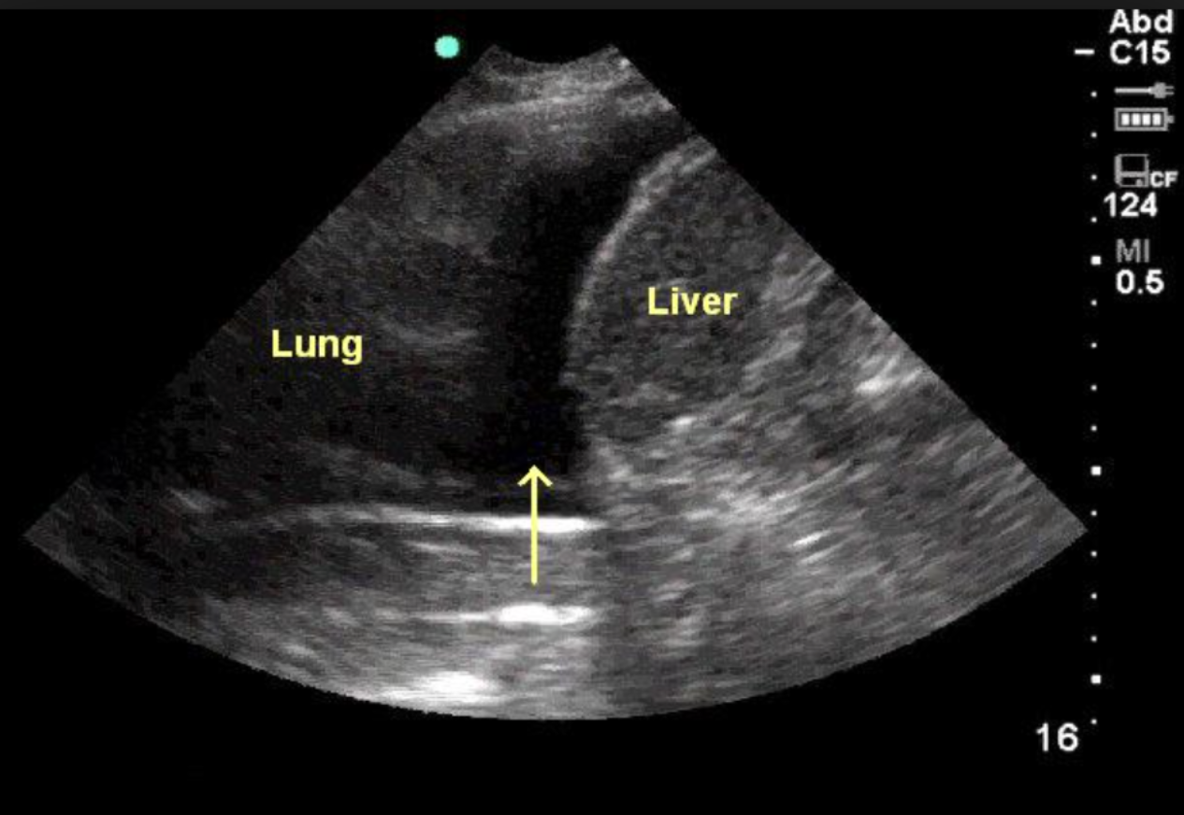
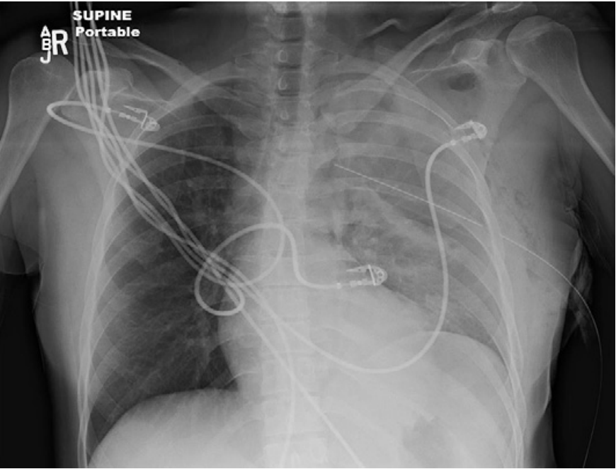
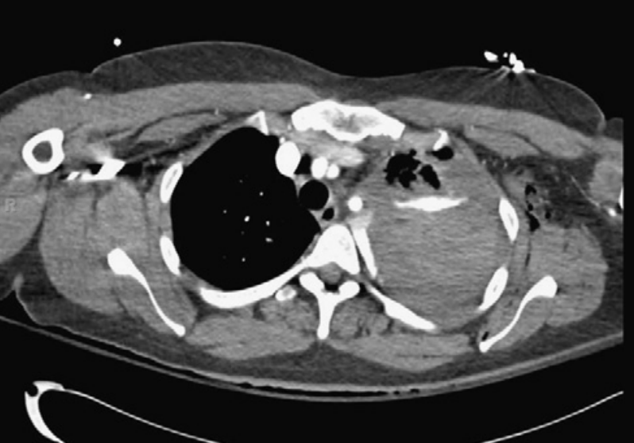
Hemothorax Workup
Put it on the differential.
  Concerning symptoms/findings: dyspnea, hyperventilation, tachycardia, chest pain, hypotension, shifting of mediastinum, external bruising, rib deformities.
Assess patient stability.
Confirm/ treat.
CT:
Can reveal blood collections missed by CXR and identifies additional abnormalities in 20-30% of chest trauma patients with normal CXR.
IMAGING
(Traumatic Hemothorax, 2017)
(Broderick, 2013)
(Broderick, 2013)
eFAST:
Can detect 100 mL of free fluid with 100% accuracy and 20 mL with a sensitivity of 67% & specificity of 99%.
CXR:
Imaging modality of choice at hospital presentation. Best assessment of volume when standing, as blunting of costophrenic angle needs 300-500 mL.

Slide 5
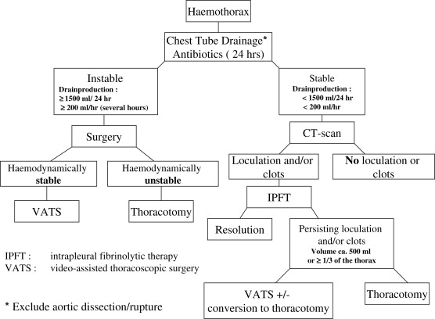
Hemothorax Algorithm
Proposed hemothorax management algorithm (Boersma et al., 2010).

Slide 6
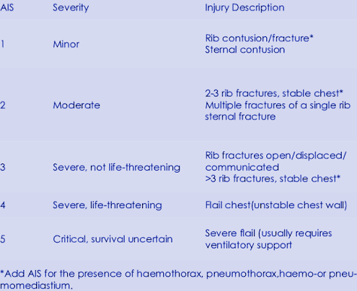
Retained Hemothorax
If blood remains within the pleural cavity after a tube thoracostomy, then it is considered a retained hemothorax.
Causes/ Risk Factors:
  Large initial blood volumes
  Blunt trauma > Penetrating trauma
  Use of multiple interventions for hemothorax
  ARDS
  Higher chest abbreviated injury scale score
  Coagulopathies
Incidence: 5-30% of hemothoraces treated with thoracostomy will exhibit a retained hemothorax.
Chest abbreviated injury scale sore (Acar et al., 2024).

Slide 7
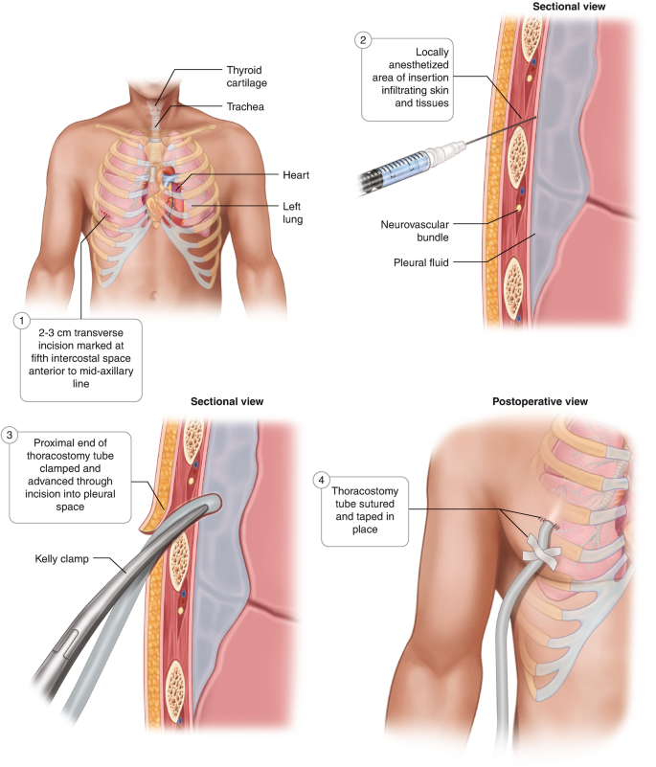
Management of Retained Hemothorax
Evacuation of retained hemothorax begins with initial chest tube placement for drainage of the hemothorax.
Within 1-4 days post inciting trauma, completion of a video-assisted thoracoscopic surgery (VATS) is the gold standard for treatment.
  Waiting longer than 6+ days post trauma is associated with 15.8% requiring more evacuation procedures and potentially a thoracotomy.
Other/ experimental strategies:
  Intrapleural Fibrinolytic Therapy
  Intrathoracic lavage
  Thoracic Irrigation
(Chawla, 2023)

Slide 8
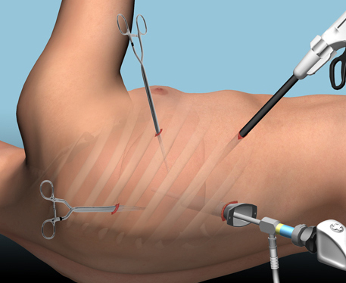
VATS
Procedure:
  Considered minimally invasive.
  Performed by cardiothoracic surgeon.
  A camera (thoracoscope) is inserted between the ribs on one end while surgical instruments are inserted into a different location.
  Surgeon manually manipulates to perform desired procedure.
Indications:
  Retained hemothorax, cancers, pericardial effusion, myasthenia gravis, et cetera.
Complications:
  Lung perforation, abnormal heart rhythm, bleeding, pneumonia, air leak
Rendering of VAR set-up (The Trauma Pro, 2017).

Slide 9
VATS vs IPFT
Video-Assisted Thoracoscopic Surgery (VATS)
PROS
Minimally invasive
Has demonstrated significant improvement in patient outcomes
Targeted removal of blood clots
GOLD STANDARD
CONS
Timing is critical.
1 out of 4 patients will require multiple evacuations.
Reliant on availability of equipment.
Intrapleural Fibrinolytic Therapy (IPFT)
PROS
Based on premise of issues with clot breakdown.
May reduce need for surgery in patients if performed early.
Potential option for individuals that are not good surgical candidates.
CONS
Not fully validated. Pending specific fibrinolytic use and dosage for maximum therapeutic effect.
  Commonly used: tPA

Slide 10
Complications of Retained Hemothorax
Failure to effectively remove retained hemothorax can result in:
  Fibrothorax
  Trapped lung
  Infection
    Empyema
    Pneumonia
Thus, effective surgical management of retained hemothoraces is key to preventing these complications and improving patient outcomes.

Slide 11
Questions?

Slide 12
References
Acar, D., Kadıoğlu, E., Kenan, N., Doğan, E., Çap, A. M., & Yılmaz, Y. (2024). The glucose/potassium ratio exhibits a predictive role that is both earlier and more efficacious compared to the i̇nflammatory response in the context of isolated thoracic trauma. Genel Tıp Dergisi, 34(3), 358–364. https://doi.org/10.54005/geneltip.1428167
Boersma, W. G., Stigt, J. A., & Smit, H. J. M. (2010). Treatment of haemothorax. Respiratory Medicine, 104(11), 1583–1587. https://doi.org/10.1016/j.rmed.2010.08.006
Broderick, S. R. (2013). Hemothorax. Thoracic Surgery Clinics, 23(1), 89–96. https://doi.org/10.1016/j.thorsurg.2012.10.003
Hendriksen, B. S., Kuroki, M. T., Armen, S. B., Reed, M. F., Taylor, M. D., & Hollenbeak, C. S. (2019). Lytic therapy for retained traumatic hemothorax. Chest, 155(4), 805–815. https://doi.org/10.1016/j.chest.2019.01.007
Chawla, G. (2023). Intercostal Chest Tube Drainage. https://www.pulmoconsult.com/specialty-services/intercostal-chest-tube-drainage/
Patel, N. J., Dultz, L., Ladhani, H. A., Cullinane, D. C., Klein, E., McNickle, A. G., Bugaev, N., Fraser, D. R., Kartiko, S., Dodgion, C., Pappas, P. A., Kim, D., Cantrell, S., Como, J. J., & Kasotakis, G. (2021). Management of simple and retained hemothorax: A Practice Management guideline from the Eastern Association for the surgery of trauma. The American Journal of Surgery, 221(5), 873–884. https://doi.org/10.1016/j.amjsurg.2020.11.032
Tewkesbury, G., Beyer, C., Eddinger, K., McLauchlan, N., Tran, A., Cannon, J. W., & Knollmann, F. (2024). CT-based pleural effusion volume estimation formula demonstrates low accuracy and reproducibility for traumatic hemothorax. Injury, 55(1), 111112. https://doi.org/10.1016/j.injury.2023.111112
The Trauma Pro. (2017). The trauma pro. https://thetraumapro.com/2017/03/06/retained-hemothorax-part-3-vats/
Traumatic Hemothorax. Core EM. (2017). https://coreem.net/core/traumatic-hemothorax/
Villegas, M. I., Hennessey, R. A., Morales, C. H., & Londoño, E. (2010). Risk factors associated with the development of post-traumatic retained hemothorax. European Journal of Trauma and Emergency Surgery, 37(6), 583–589. https://doi.org/10.1007/s00068-010-0064-3
Zeiler, J., Idell, S., Norwood, S., & Cook, A. (2020). Hemothorax: A review of the literature. Clinical Pulmonary Medicine, 27(1), 1–12. https://doi.org/10.1097/cpm.0000000000000343

