Slide 1
Acute Mesenteric Ischemia
Jacob Bershatski (MS3)
University of Arizona College of Medicine - Tucson

Slide 2
Overview
Sudden reduction in intestinal blood flow resulting in bowel ischemia and infarction
Surgical emergency w/ 50-70% mortality rate, largely d/t delayed dx
~0.1% of hospital admissions
Early recognition and rapid revascularization are key

Slide 3
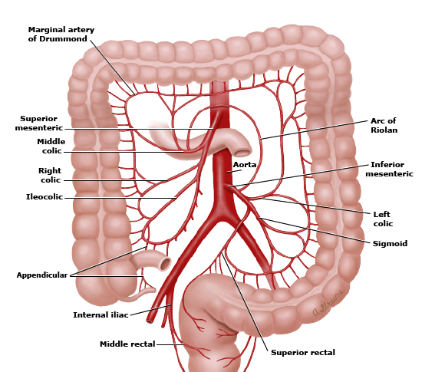
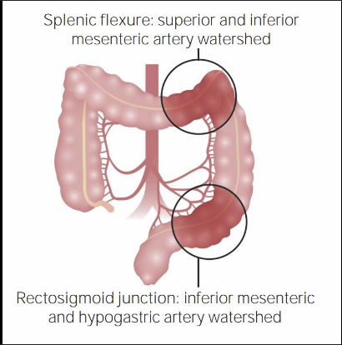
Relevant Anatomy
Most commonly involved artery is SMA

Slide 4
Etiologies
2 major categories:
  Occlusive
    Arterial embolic
    Arterial thrombotic
    Venous thrombotic
  Nonocclusive (NOMI)

Slide 5
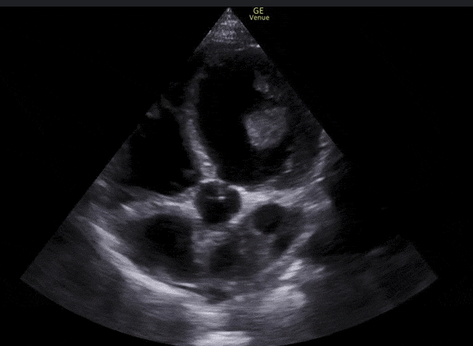
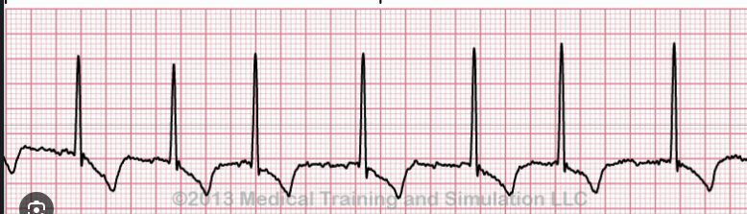
Arterial Embolic
Risk factors: A-fib/flutter, recent MI or LV thrombus, valvular heart disease (esp. mitral stenosis), infective endocarditis
Most emboli lodge in the mid/distal SMA. Proximal emboli cause more extensive bowel ischemia.

Slide 6
Arterial Thrombotic
Caused by acute thrombosis of a pre-existing atherosclerotic plaque
Risk factors:
  ASCVD (e.g., smoking, HTN, diabetes, HLD, etc.)
  History of MI, CVA, or PAD
Patients may have preceding chronic mesenteric ischemia (postprandial pain, weight loss)

Slide 7
Venous Thrombotic
Most common is superior mesenteric vein thrombosis
  Increases capillary hydrostatic pressure
  Causes bowel wall edema
  Eventually impairs arterial inflow, leading to ischemia
Often in younger patients w/ underlying hypercoaguable disorder
Unlike arterial occlusion, focus on anticoagulation rather than revascularization

Slide 8
Nonocclusive Mesenteric Ischemia
Hypoperfusion causes intense splanchnic vasoconstriction, leading to ischemia
No arterial or venous occlusion involved
Risk Factors: anything that significantly decreases bowel perfusion
  Shock
  HF
  Vasopressor use
  Severe burns or critical illness
Goal is to restore perfusion

Slide 9
Clinical Presentation
History:
  Constant, severe abdominal pain
  Pain out of proportion to exam
  N/V/D
  Bloody stools (late)
Physical Exam:
  Hypovolemia (NOMI)
  Early: minimal TTP, soft abdomen
  Late: peritoneal signs

Slide 10
Workup
Labs (may be normal early):
  Leukocytosis
  Elevated lactate
  Metabolic acidosis
CTA a/p with IV contrast (1st-line imaging):
  Vascular: SMA occlusion
  Bowel wall thickening + mesenteric edema
  Decreased or absent bowel wall enhancement
  Pneumatosis intestinalis

Slide 11
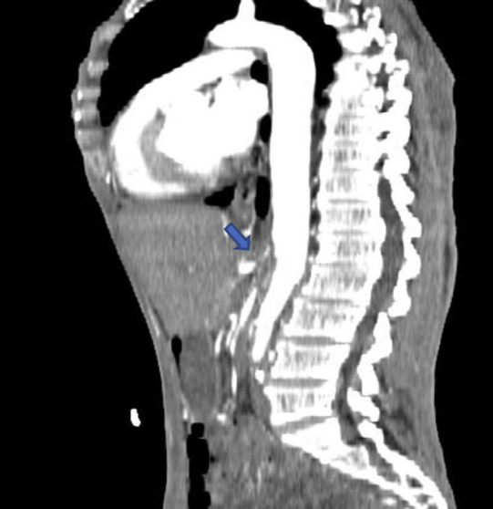
SMA Occlusion

Slide 12
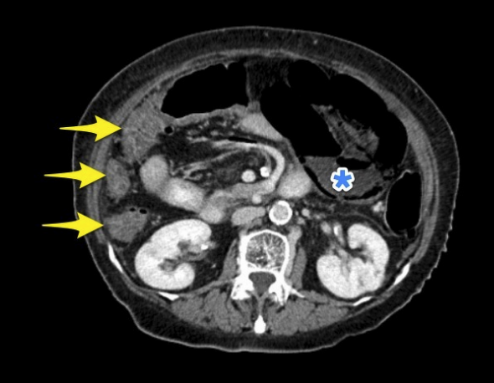
Bowel wall hypoenhancement

Slide 13
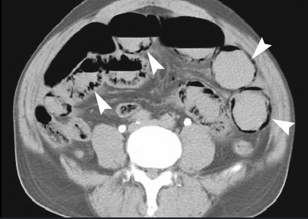
Pneumatosis intestinalis

Slide 14
Acute Management
Resuscitation:
  Aggressive IV fluids
  NPO
  Supplemental O2
Supportive Care:
  Broad-spectrum abx
  NG tube decompression (if ileus/obstruction)
Etiology-specific
  IV heparin (embolic/thrombotic)
  Reverse hypotension/shock (NOMI)
  D/C vasopressors (NOMI)

Slide 15
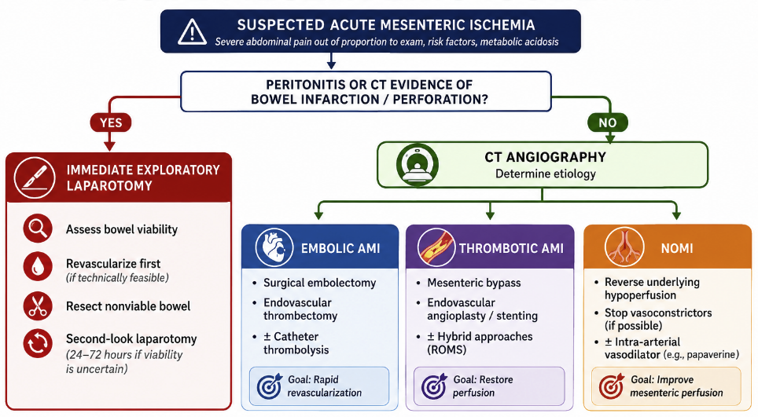
Surgical Management

Slide 16
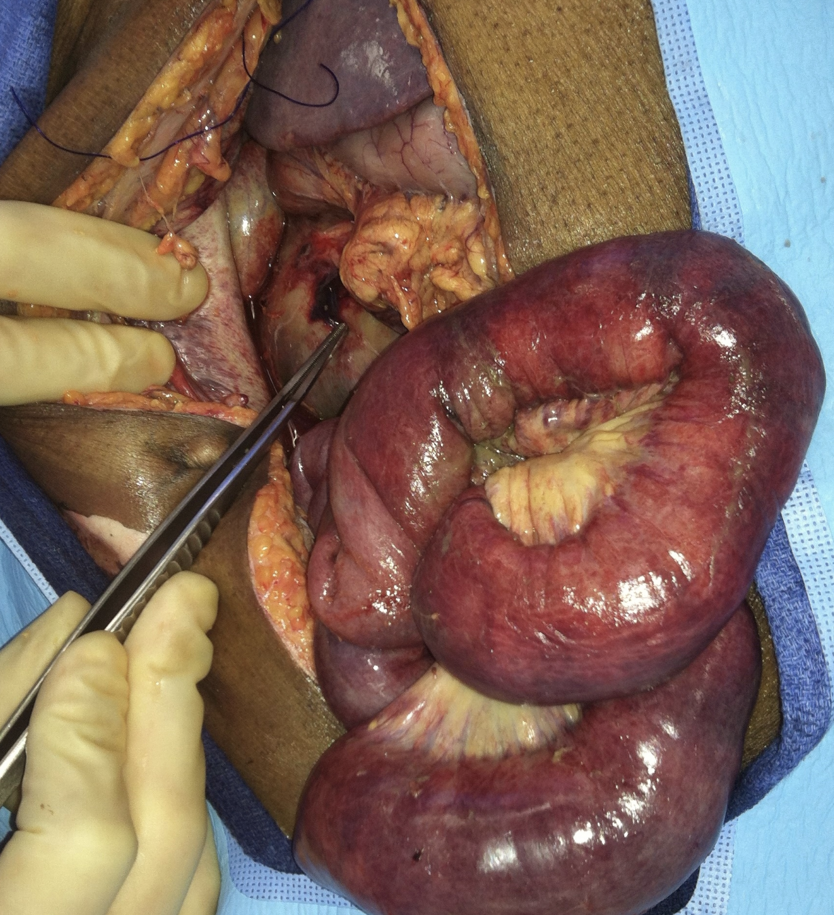

Slide 17
Citations
Bala, M., et al. (2022). Acute mesenteric ischemia: Updated guidelines of the World Society of Emergency Surgery. World Journal of Emergency Surgery, 17(1), 54. https://doi.org/10.1186/s13017-022-00443-x
Lendzion, R. J., et al. (2022). Acute mesenteric ischemia. Clinics in Colon and Rectal Surgery, 35(3), 227–236. https://doi.org/10.1055/s-0042-1743283
Bourcier, S., et al. (2021). Non-occlusive mesenteric ischemia: Diagnostic challenges and perspectives in the era of artificial intelligence. World Journal of Gastroenterology, 27(26), 4088–4103. https://doi.org/10.3748/wjg.v27.i26.4088
Hmoud, B., et al. (2014). Mesenteric venous thrombosis. Journal of Clinical and Experimental Hepatology, 4(3), 257–263. https://doi.org/10.1016/j.jceh.2014.03.052
Liao, G., et al. (2019). Review: Acute superior mesenteric artery embolism: A vascular emergency cannot be ignored by physicians. Medicine, 98(6), e14446. https://doi.org/10.1097/MD.0000000000014446

