Slide 1
Gallstone Pancreatitis
Cameron Mortazavi, MS3
Surgery Clerkship

Slide 2
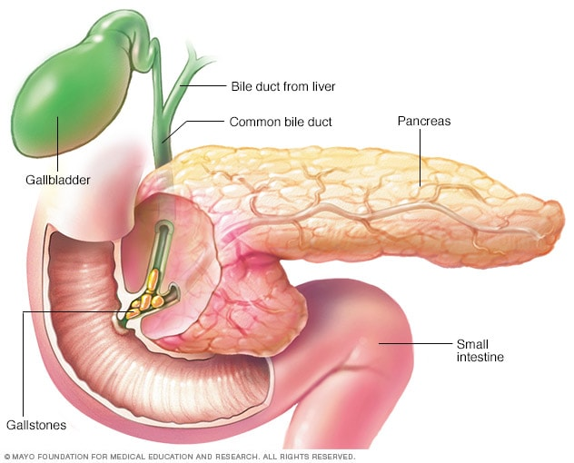
Definitions & Anatomy
Gallstone disease is the leading cause of acute pancreatitis, accounting for ~50% of cases, with an incidence of ~40 per 100,000 annually in the US.
Transient obstruction of the ampulla of Vater by a migrating gallstone
  Increase ductal pressure
  Interstitial edema
  Premature activation of trypsinogen to trypsin within the pancreatic acini → autodigestion of the pancreatic parenchyma

Slide 3
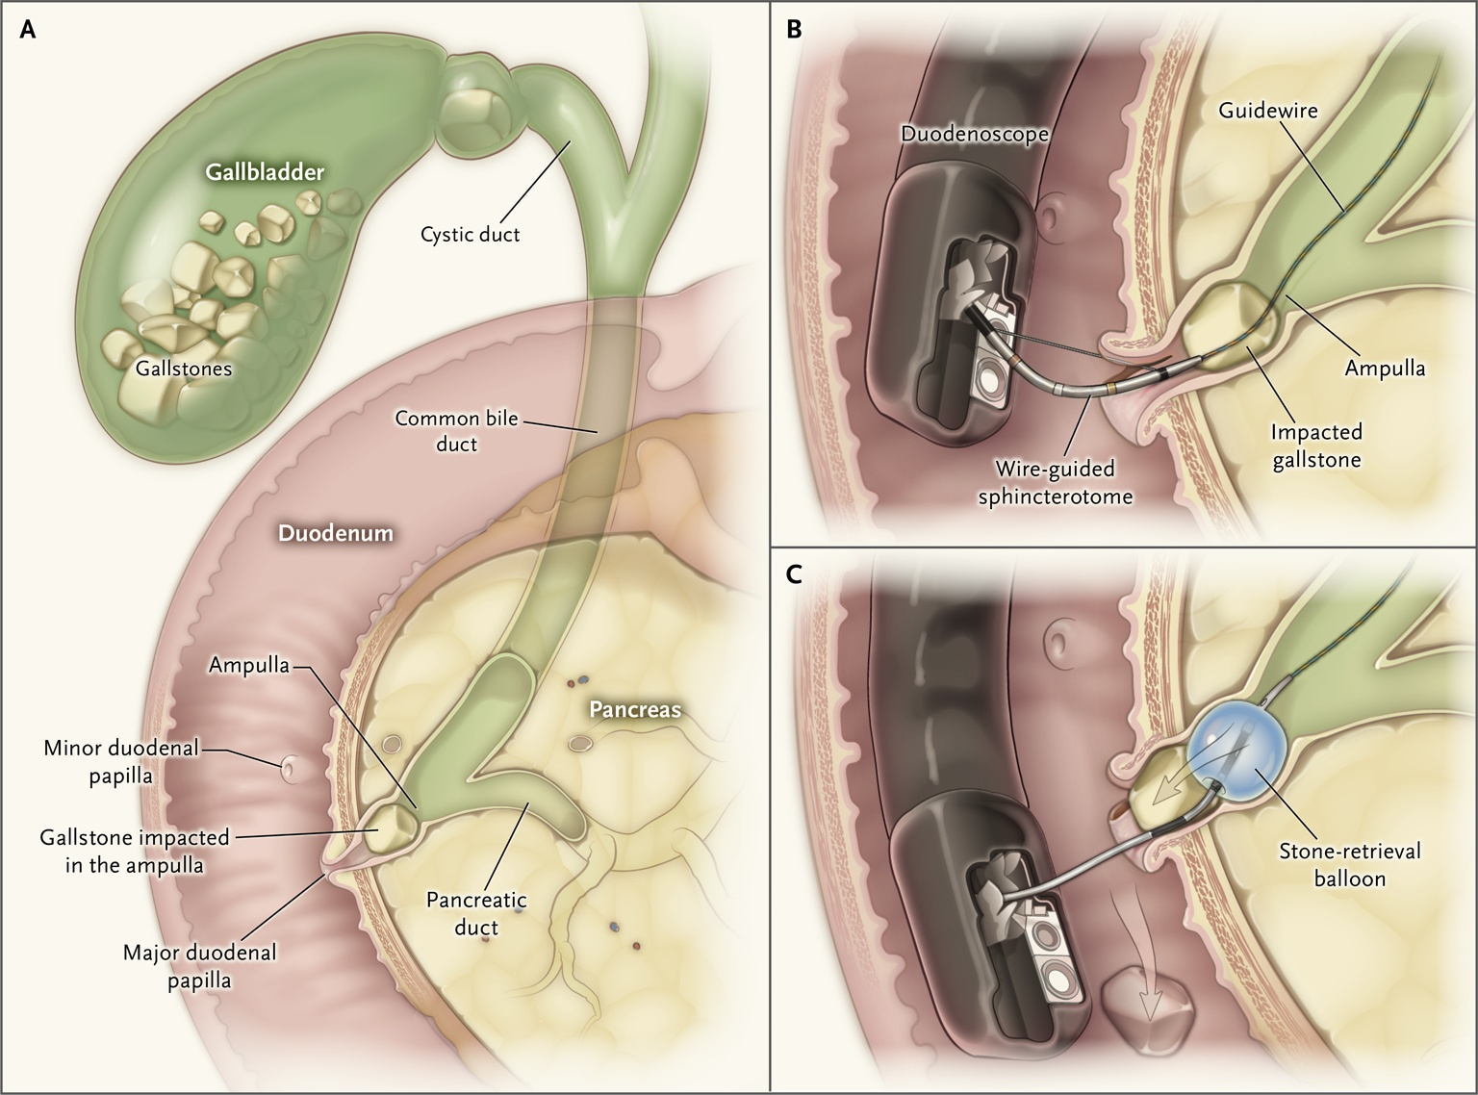
Etiology
Risk factors ("Goldilocks" concept):
  Small stones <5 mm,
  Large cystic duct >5 mm
  >20 gallstones in the gallbladder
  The stone must be small enough to exit the cystic duct but large enough to transiently obstruct the common channel.
Other causes of acute pancreatitis:
  Alcohol (2nd most common)
  Hypertriglyceridemia (>1000 mg/dL)
  Hypercalcemia
  Post-ERCP (5–10% risk)
  Medications
  Hereditary/genetic
  Autoimmune

Slide 4
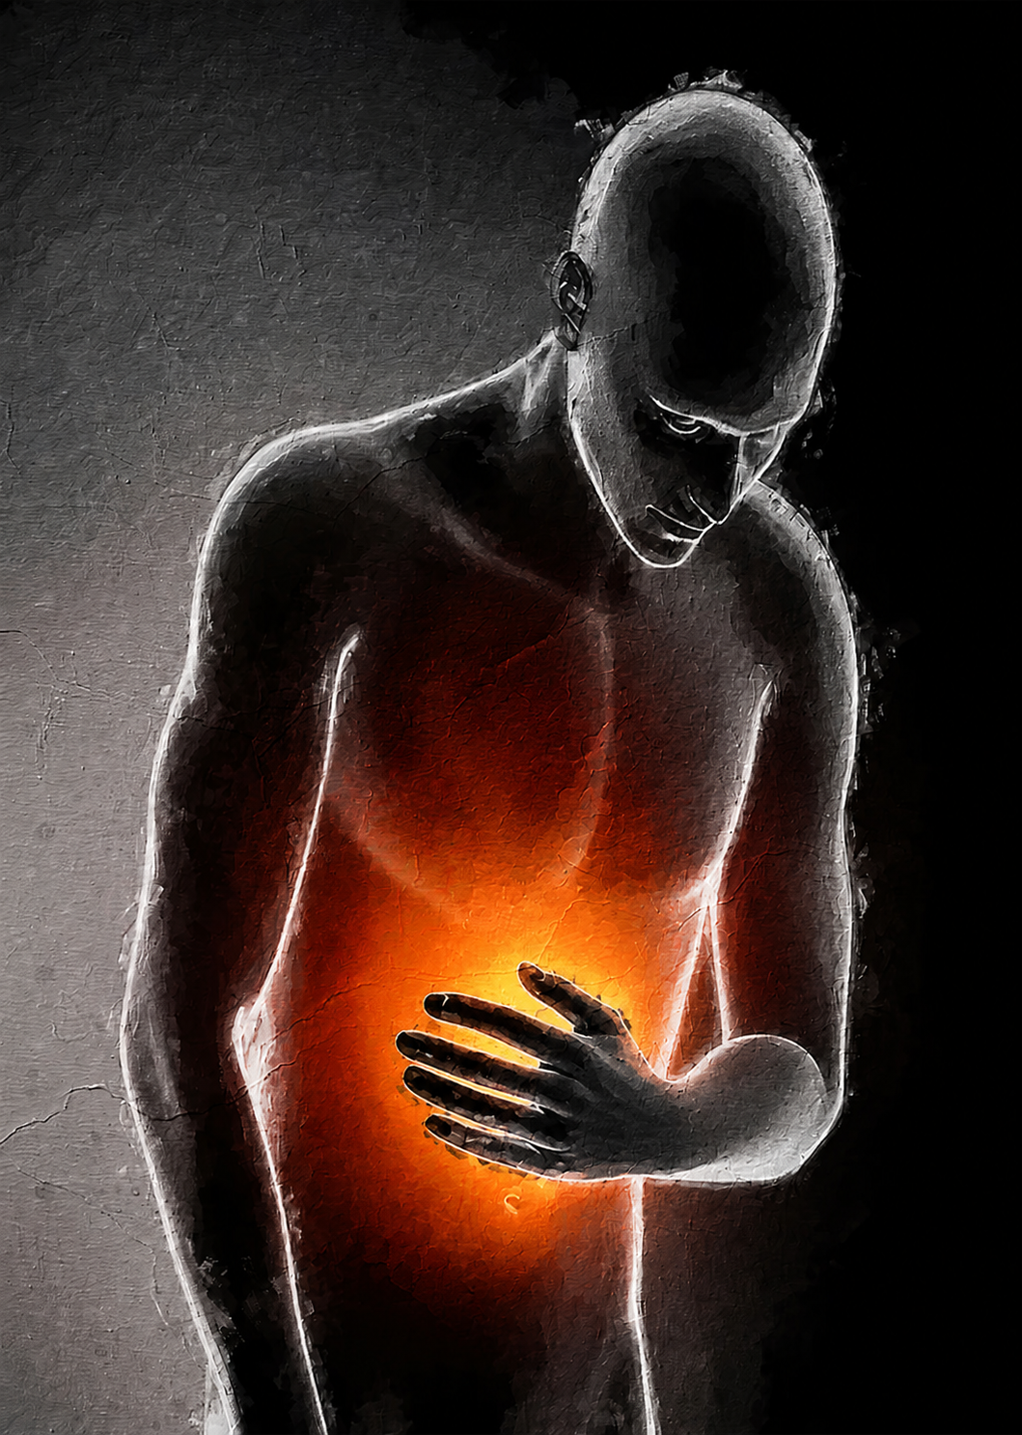
Signs/Symptoms
Constant, severe, epigastric pain often radiating to the back, exacerbated by eating, drinking, or lying supine.
Nausea and vomiting
Low- to moderate-grade fever
Abdominal distention , decreased bowel sounds
Features suggestive of biliary etiology :
  History of biliary colic or known gallstone disease
  Jaundice — if present, suggests persistent CBD obstruction
  Lab/Image findings

Slide 5
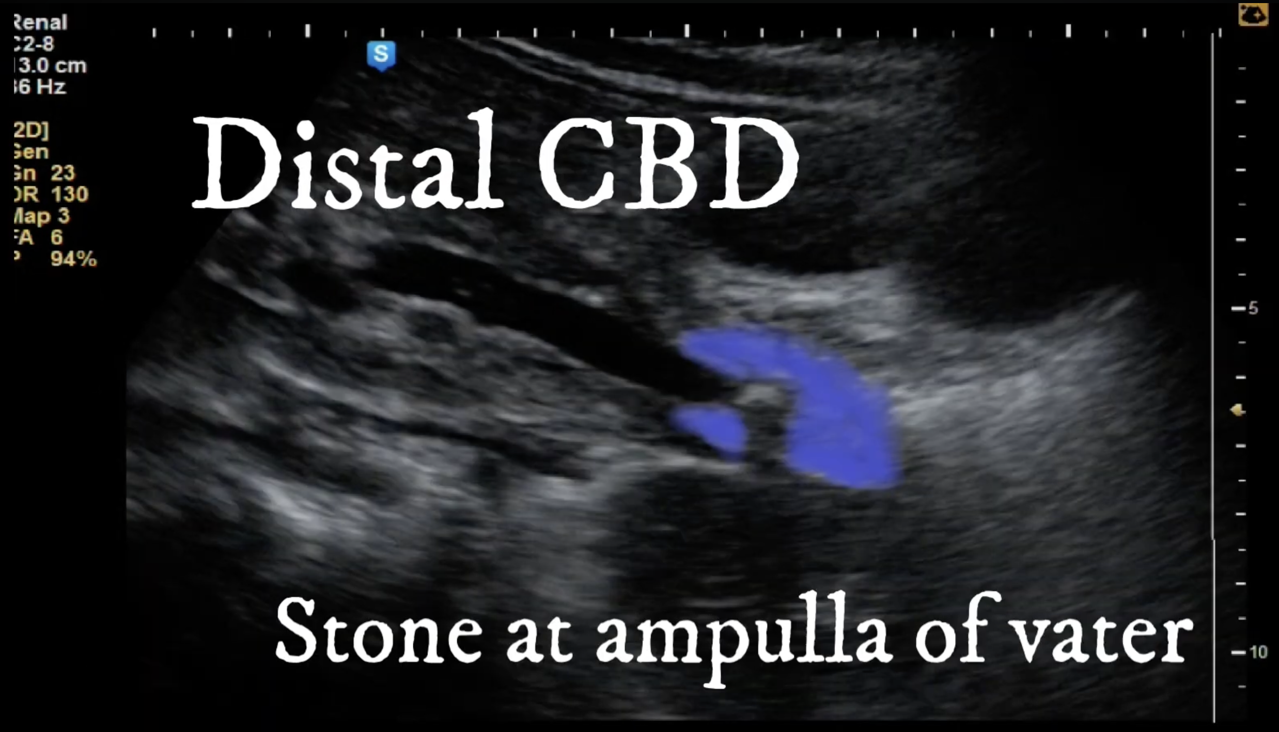
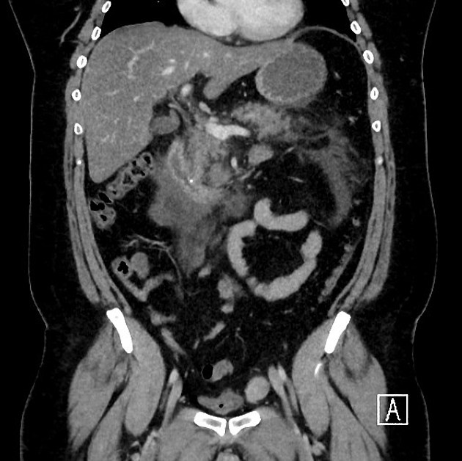
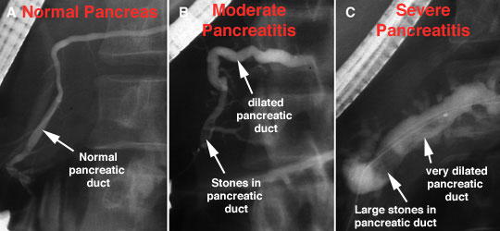
Labs/Imaging
Labs
  Elevated ALT ≥3× normal — PPV ~95% for gallstone pancreatitis
  Elevated direct/total bilirubin, AST, Alk Phosphatase → indicates choledocholithiasis or recent stone passage or concurrent biliary disease
  Elevated fever and leukocytosis→ ascending cholangitis or necrotizing pancreatitis
Imaging
  Abdominal US: great preliminary read/quick to do in ED.
  CT: great for assessing severity/extent of disease
  MRCP: best non-invasive test
  Endoscopic US: Comparable to MRCP (sensitivity/specificity)
  ERCP: invasive and therapeutic (gold standard)

Slide 6
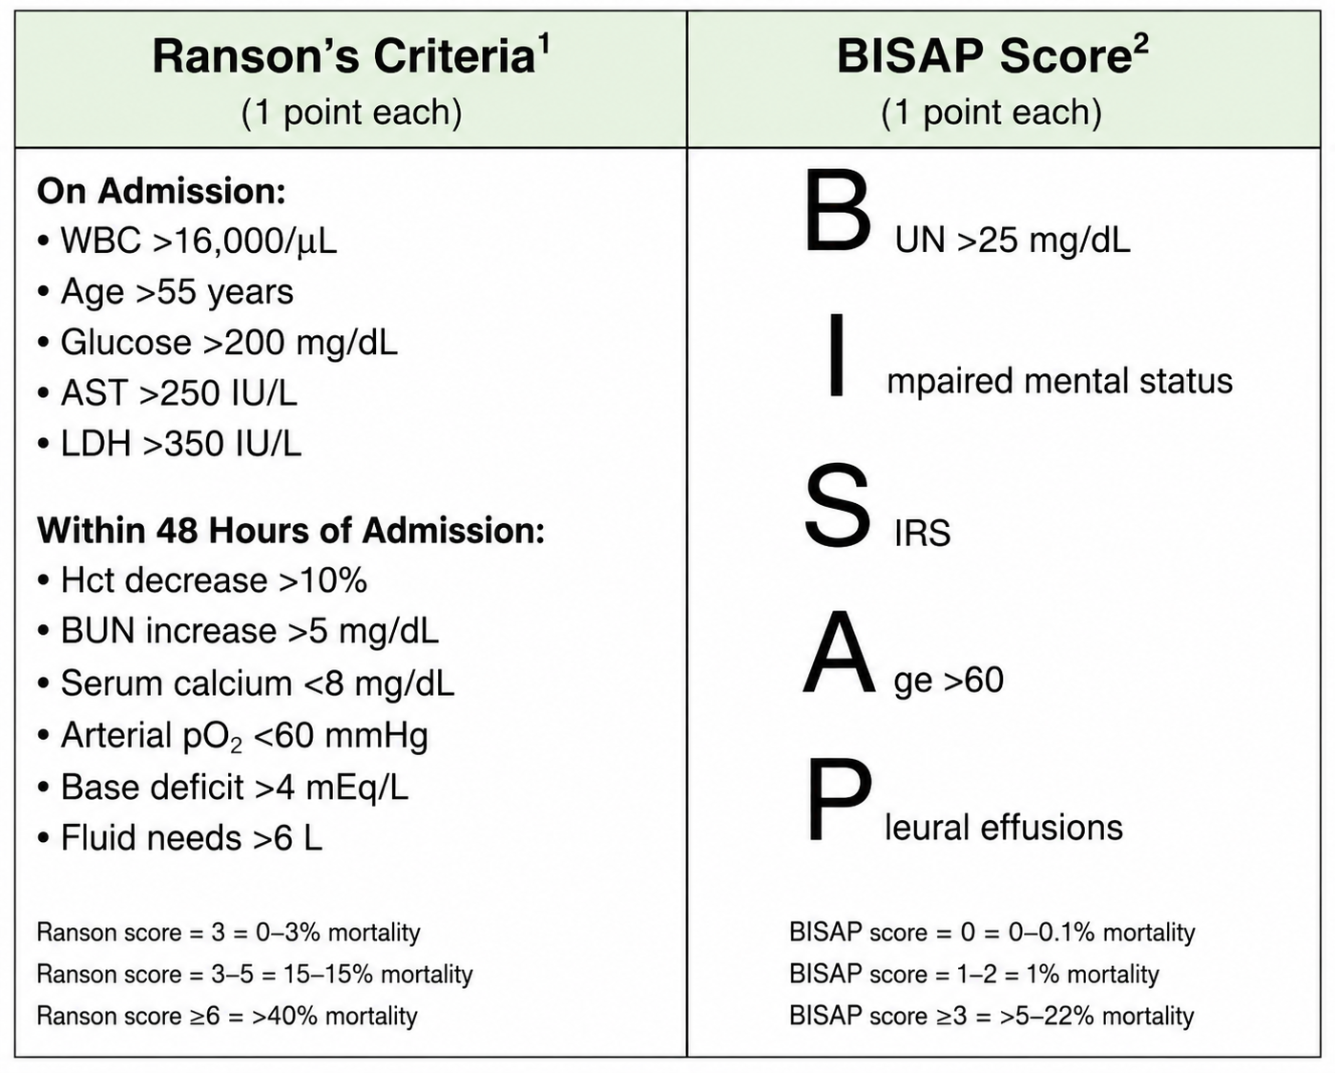
Diagnosis and Determining Severity
Severity Indexes
Revised Atlanta Classification
Diagnosis (2/3)
- Acute onset of persistent, severe epigastric pain, radiating to back
Serum Lipase/Amylase ≥ to 3x upper limit
Findings suggestive of gallstone pancreatitis on imaging
Staging
Early phase (first 1–2 weeks): SIRS/organ failure.
Late phase (>2 weeks): Characterized by local complications
  Necrosis, fluid collections, infection
  Not all patients have this phase
Utilizes the Modified Marshall Scoring System to aid with severity of systemic disease
Requires 48 hrs.
Within 24 hours

Slide 7
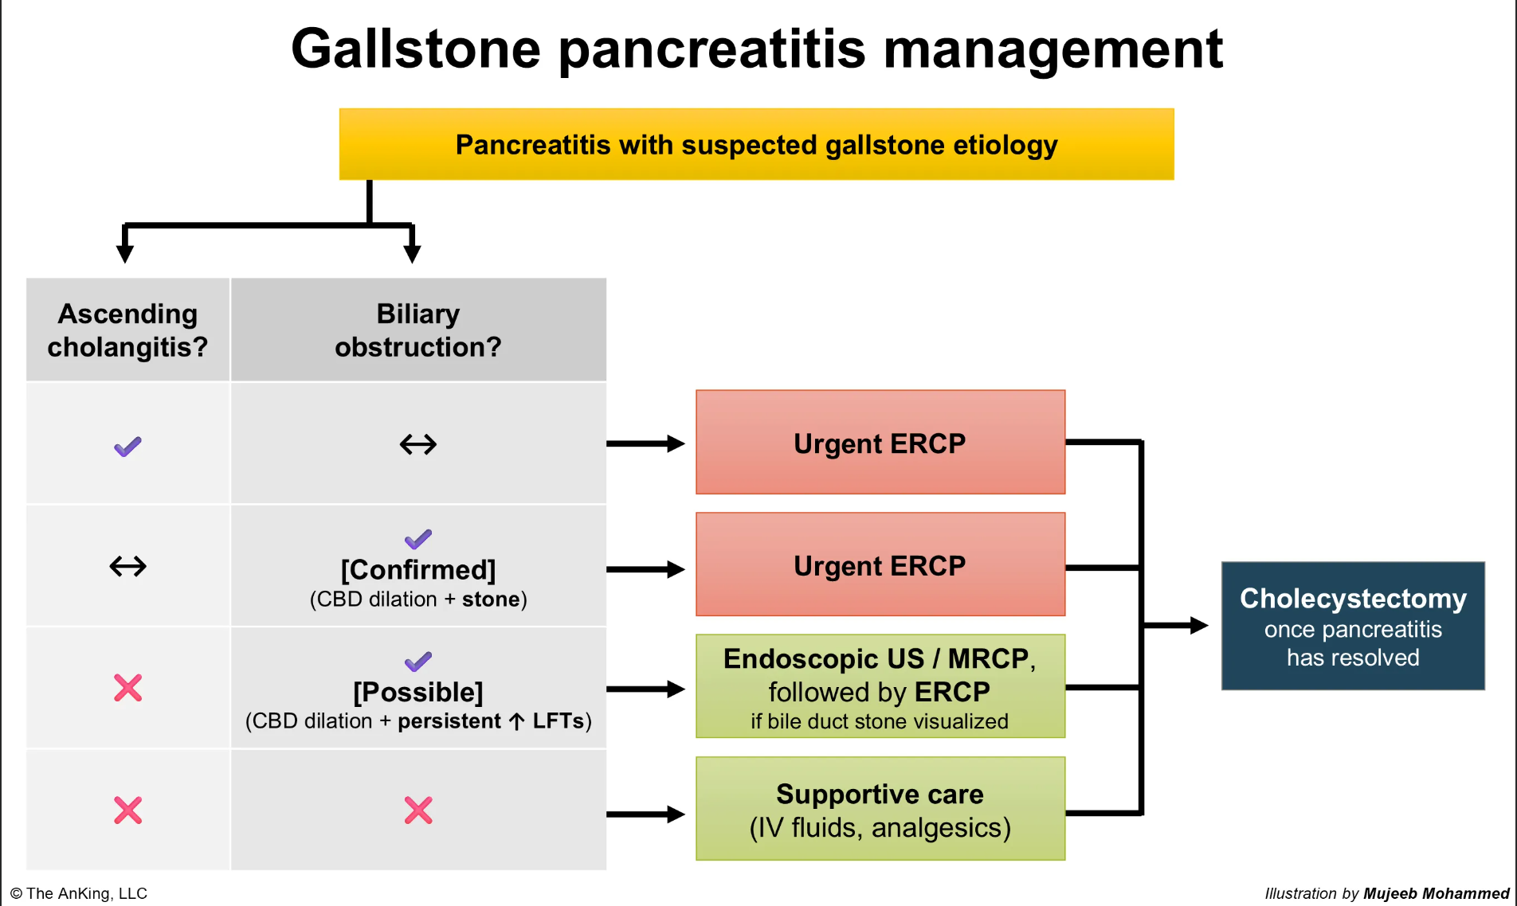
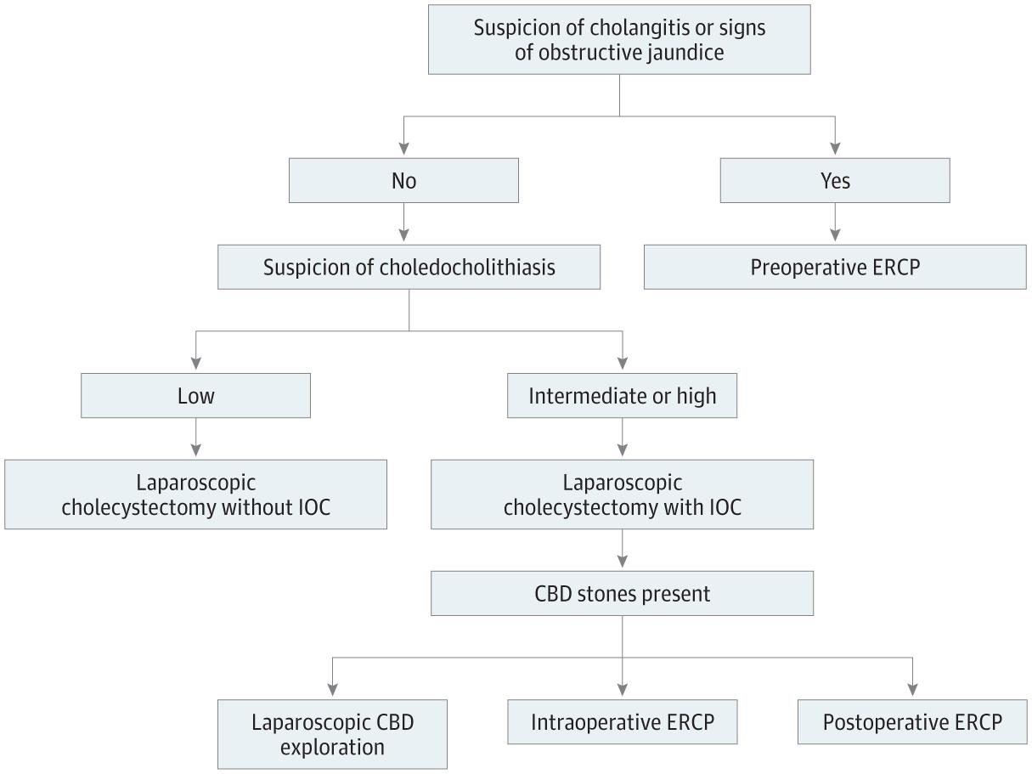
Treatment
Begin with fluids resuscitation and nutritional support
LR > NS @ 1.5 mL/kg/hr in non-hypovolemic patients, bolus of 10 mL/kg if hypovolemic for aggressive resuscitation (Waterfall trial)
Pain management/analgesics (caution with opioids)
Nutrition: Early oral feeding per tolerated. If nor oral, Enteral (NJ tube) > TPN
Routine ERCP not indicated – most stones pass spontaneously.
  Indicated if:
    Suspected concurrent cholangitis
    Persistent biliary obstruction
    Patients who are poor surgical candidates (consider ERCP with sphincterotomy)
IV antibiotics only if concurrent cholangitis or infected pancreatic necrosis
Cholecystectomy
Notes:
Waterfall Trial: https://www.nejm.org/doi/full/10.1056/NEJMoa2202884
The WATERFALL trial (Early Weight-Based Aggressive vs. Nonaggressive Goal-Directed Fluid Resuscitation in the Early Phase of Acute Pancreatitis) was a landmark multicenter, open-label randomized controlled trial published in the New England Journal of Medicine in 2022 that enrolled 249 patients across 18 centers in 4 countries. Patients were randomized to aggressive fluid resuscitation (20 mL/kg Lactated Ringer's bolus followed by 3 mL/kg/hr) versus moderate fluid resuscitation (10 mL/kg bolus only if hypovolemic, no bolus if euvolemic, followed by 1.5 mL/kg/hr), with goal-directed reassessment at 3, 12, 24, 48, and 72 hours. The trial was stopped early by the data safety monitoring board due to significantly higher rates of fluid overload in the aggressive group (20.5% vs. 6.3%; adjusted RR 2.85; p = 0.004), with no benefit in the primary outcome of moderately severe or severe pancreatitis (22.1% vs. 17.3%; p = 0.32). This trial fundamentally shifted the paradigm of fluid management in acute pancreatitis away from the traditional teaching of aggressive hydration, and current guidelines (ACG 2024, WSES) now recommend moderate, goal-directed fluid resuscitation with Lactated Ringer's at 1.5 mL/kg/hr as the standard of care.

Slide 8
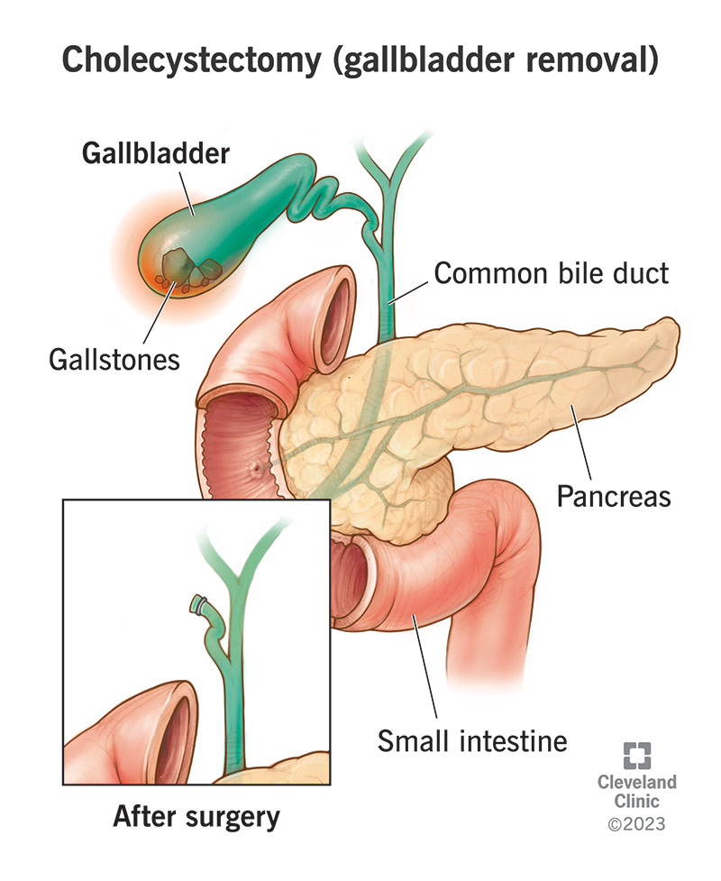
Treatment pt. 2 – Timing of Cholecystectomy
Mild GSP: Same-admission cholecystectomy, ideally within 48 hours of admission, is strongly recommended.
  If same-admission cholecystectomy is not feasible: Perform within 2–4 weeks of discharge
Severe GSP: Cholecystectomy should be delayed due to risk of superinfection of peripancreatic collections. Typically delayed until collections resolve or ≥6 weeks after the episode
Moderately severe GSP: Optimal timing remains unclear and is an area of active study.
Without cholecystectomy, 8% recurrence within a median of 40 days, rising to 22% at 5 years.

Slide 9
Complications
Most stones pass into the duodenum without the need for intervention
Same complications as acute pancreatitis
  Local:
    Acute peripancreatic fluid collections
    Acute necrotic collections
    Pseudocysts (>4 weeks)
    Walled-off necrosis (>4 weeks)
    Infected necrosis carries ~25% mortality vs. ~10% for sterile necrosis
  Systemic/Organ failure:
    Pulmonary (ARDS, 15–55% in severe cases)
    Renal failure
    Cardiovascular shock
    Persistent organ failure (>48 h) defines severe disease →most important determinant of outcome.
  Management of infected necrosis:
    Step-up approach (percutaneous/endoscopic drainage → minimally invasive necrosectomy if needed)

Slide 10
Takeaways
GSP is caused by transient ampullary obstruction; most stones pass spontaneously
Diagnose with lipase ≥3× ULN + ultrasound/imaging showing gallstones; ALT ≥3× ULN strongly suggests biliary etiology
Classify severity early (BISAP or Revised Atlanta) to guide management
Moderate fluid resuscitation with LR; avoid aggressive over-hydration
ERCP only if cholangitis or persistent biliary obstruction
Same-admission cholecystectomy for mild/moderate disease; delay for severe disease
Without cholecystectomy, recurrence risk is substantial

Slide 11
References
https://www.mayoclinic.org/diseases-conditions/pancreatitis/multimedia/pancreatitis-caused-by-gallstones/img-20007560
https://jamanetwork.com/journals/jamasurgery/fullarticle/10.1001/jamasurg.2023.8111?utm_source=openevidence&utm_medium=referral
https://pubmed.ncbi.nlm.nih.gov/39469538
https://jamanetwork.com/journals/jama/fullarticle/10.1001/jama.2020.20317?utm_source=openevidence&utm_medium=referral
https://www.cochranelibrary.com/cdsr/doi/10.1002/14651858.CD009779.pub2/full
https://pubmed.ncbi.nlm.nih.gov/32891214
https://doi.org/10.14309/ajg.0000000000002645
https://www.nejm.org/doi/full/10.1056/NEJMoa2202884?utm_source=openevidence
https://pubmed.ncbi.nlm.nih.gov/18191686
https://pubmed.ncbi.nlm.nih.gov/30768987
https://www.cochranelibrary.com/cdsr/doi/10.1002/14651858.CD011384.pub2/full
https://www.nejm.org/doi/full/10.1056/NEJMct1208450?utm_source=openevidence
https://pubmed.ncbi.nlm.nih.gov/15278046
https://pubmed.ncbi.nlm.nih.gov/39469538
https://pubs.rsna.org/doi/abs/10.1148/rg.2016150097
https://pancreas.org/patients/testing-procedures/anatomic/
https://www.youtube.com/watch?v=n1HeGI2Sp6A

